Slide 1
RCG|enable™ Banking
Demo Script
April 2017

Slide 2
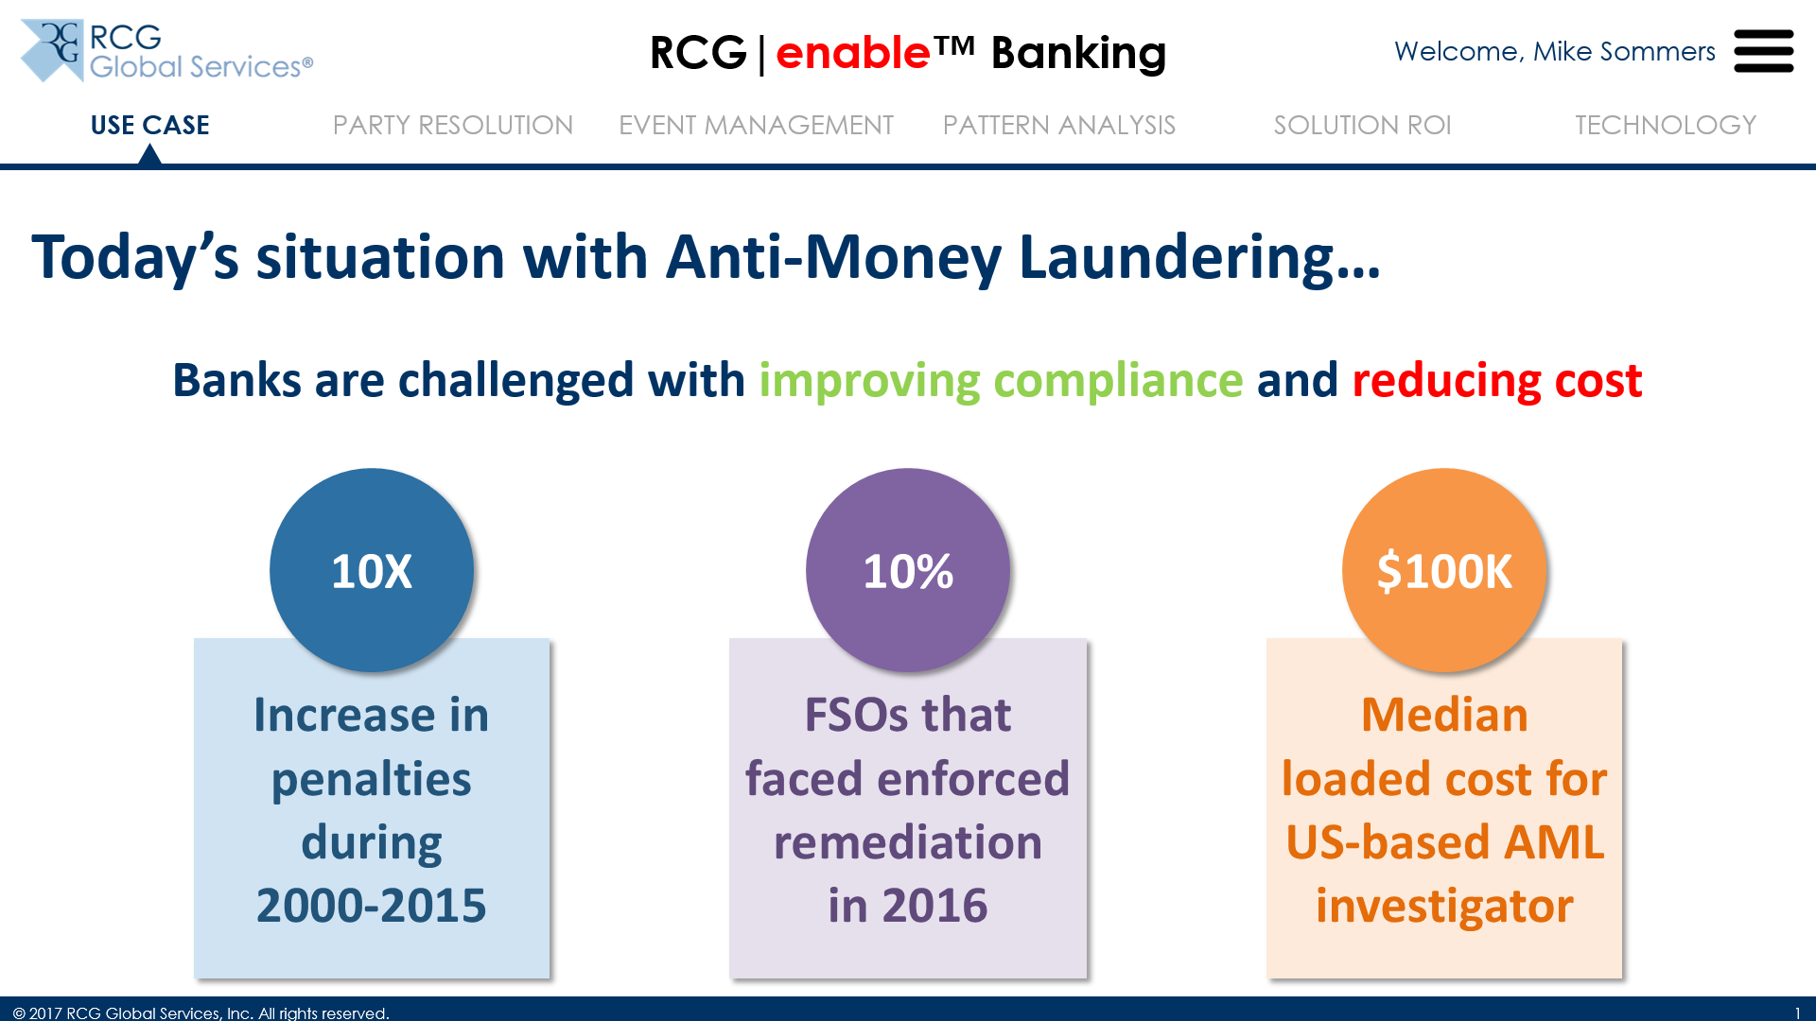
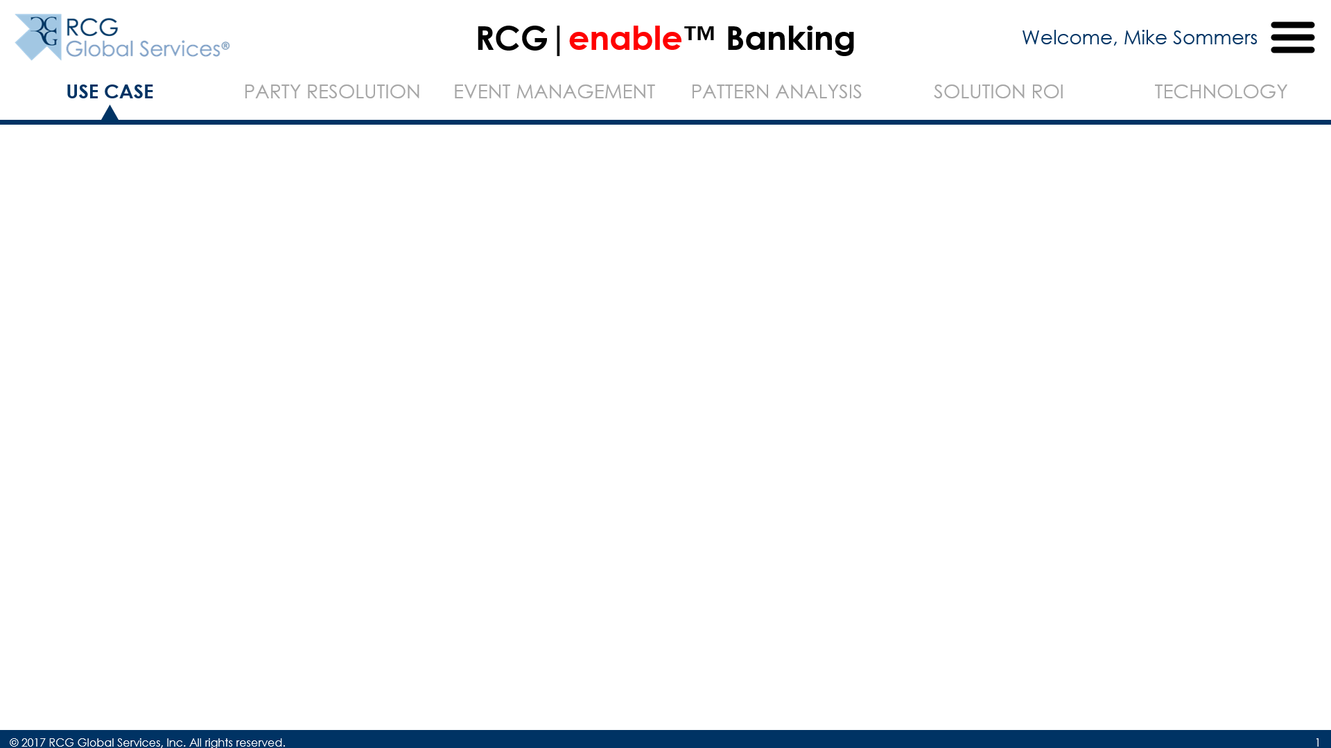
Introduction
http://banking.rcgenable.com
(Use Google Chrome to go to the URL above)
Use the key terms “improving compliance” and “reducing cost”, and highlight the industry statistics

We’ll talk about the Use Case in detail first, followed by the key concepts of our RCG|enable™ Banking solution (Party Resolution, Event Management and Pattern Analysis)
We’ll wrap it up with a discussion on Solution ROI and the underlying architecture and Technology
Call the audience’s attention to this area

Slide 3
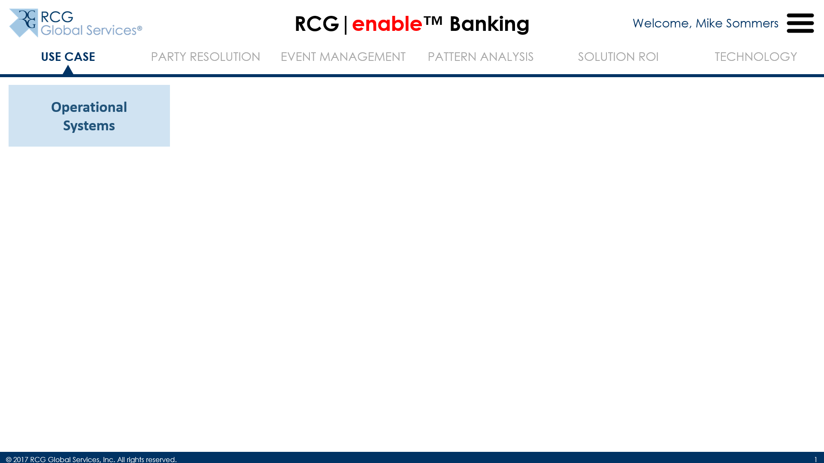
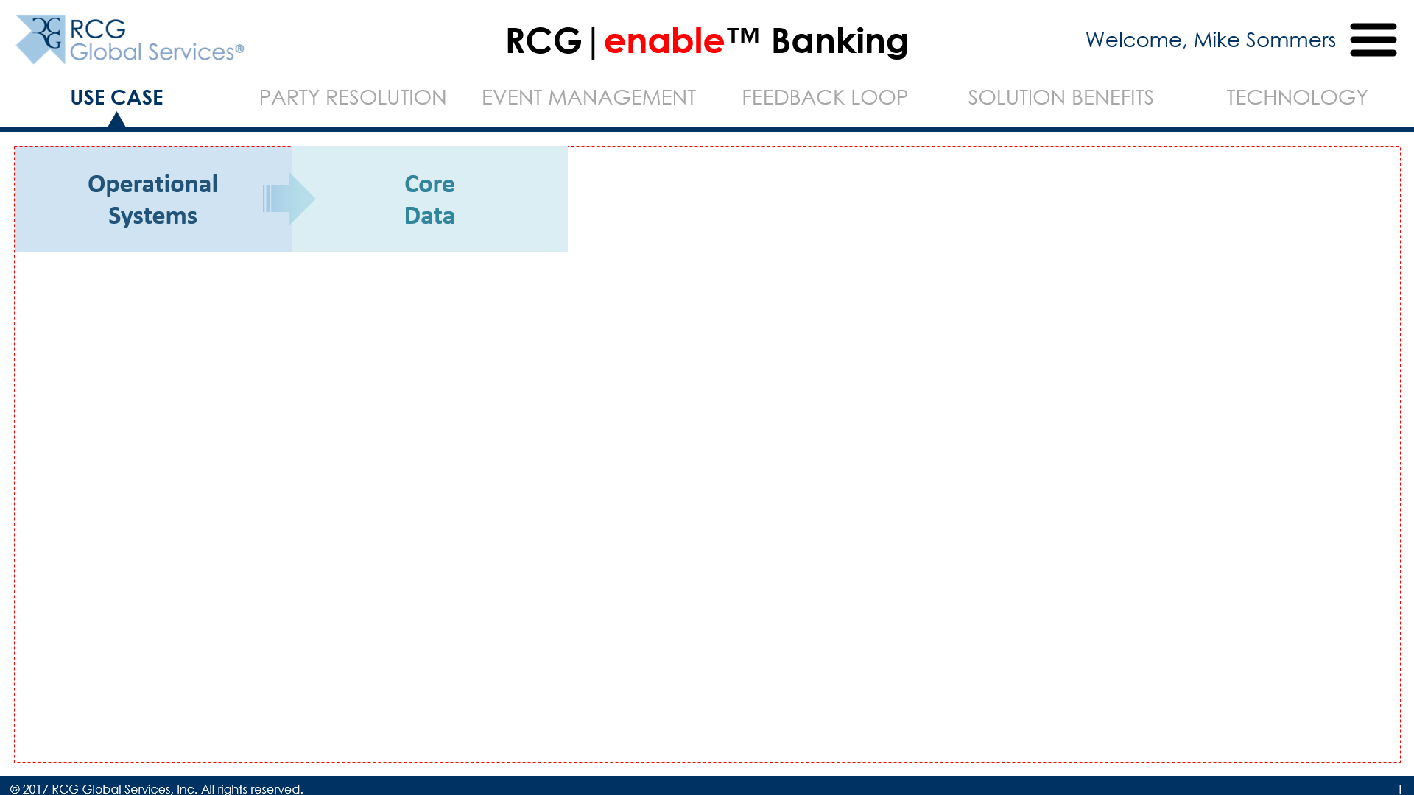
Use Case
 Your Operational Systems…
 … provide Core Data that are subject to scrutiny – to both prevent and investigate financial crime

Slide 4
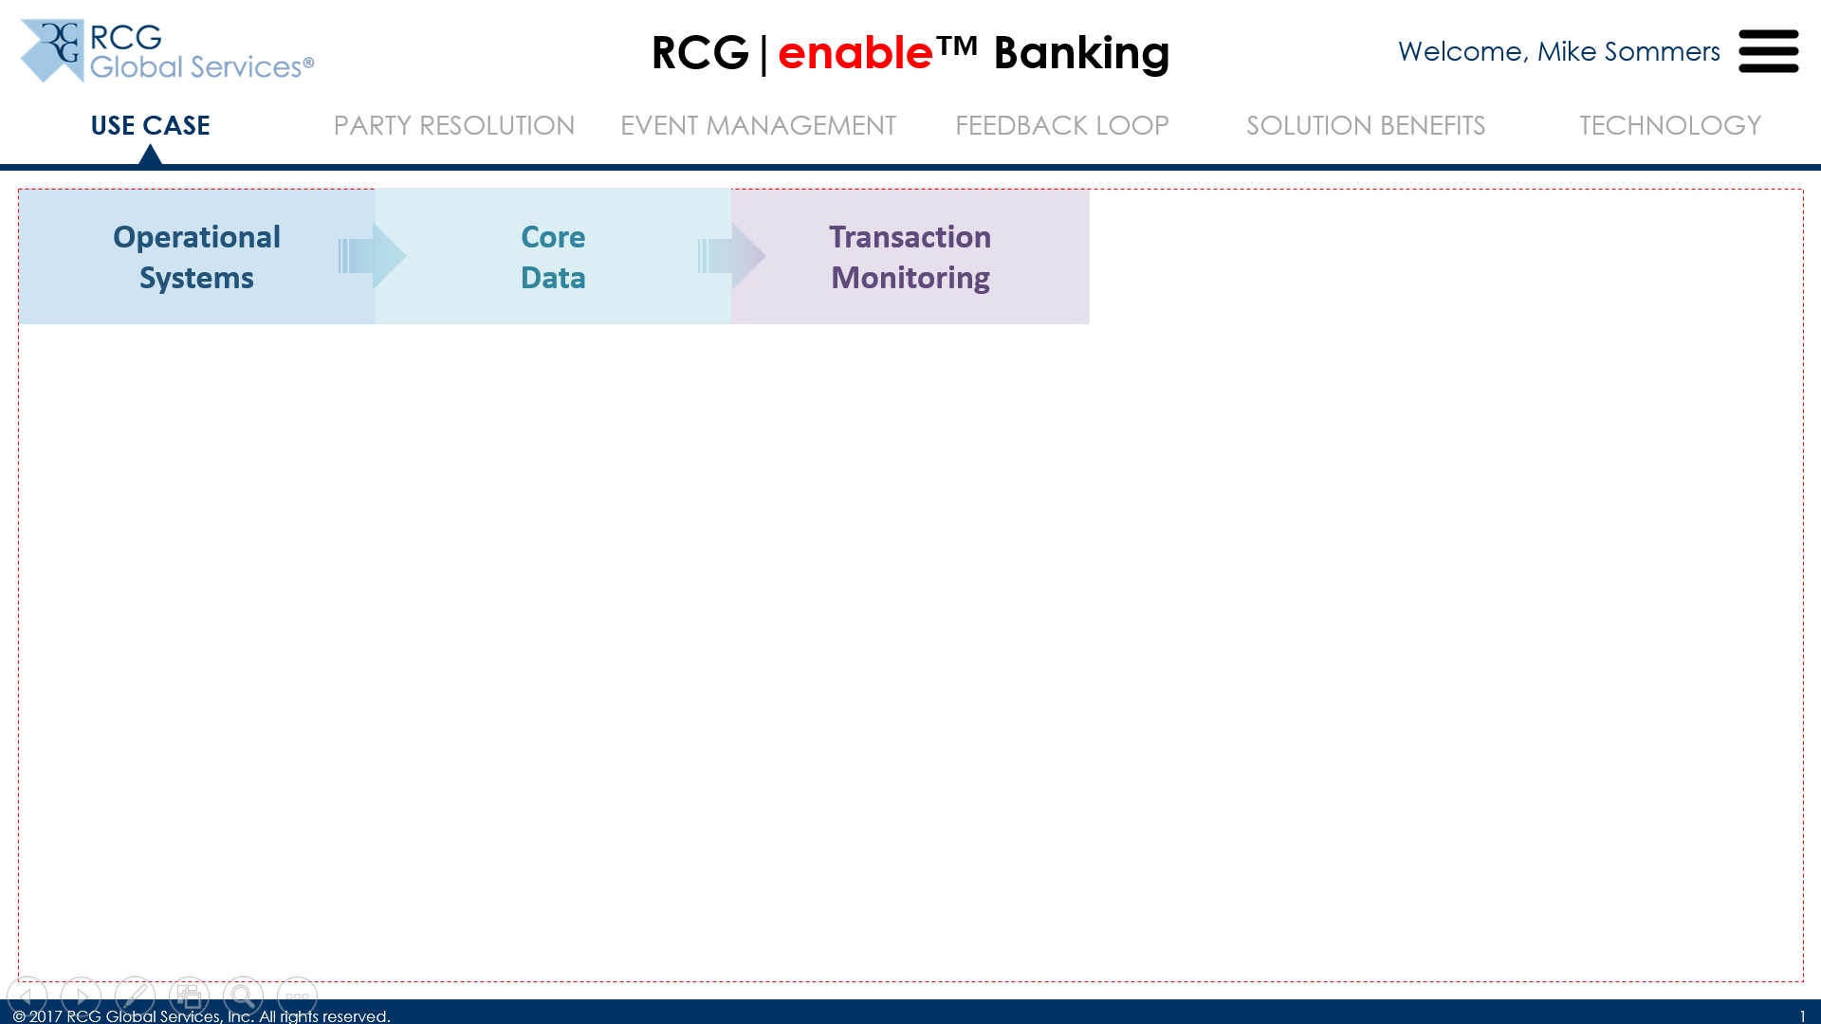
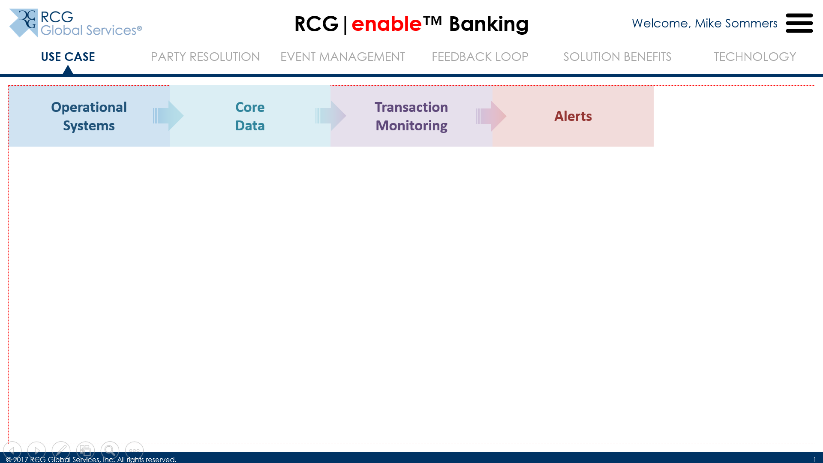
Use Case

Transactions, specifically, must be monitored constantly

Alerts generated from monitoring must be investigated…

Slide 5
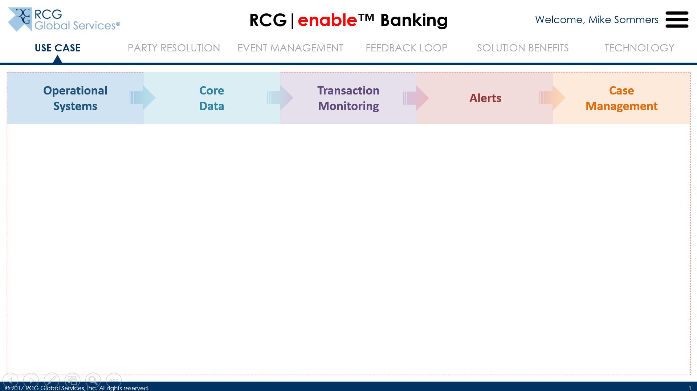
Use Case

… for which you probably already have a case management tool in-house
(Now is a good time to ask them what TMS and CMT they have)
Let’s take a closer look at the process with some illustrative numbers

Slide 6
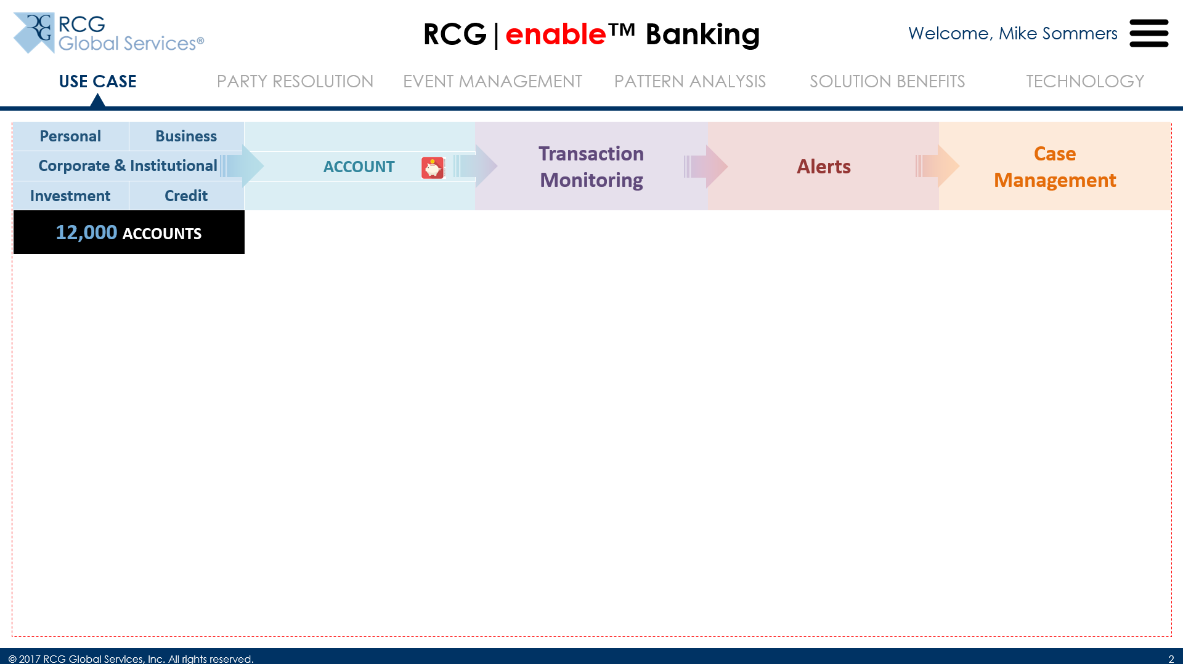
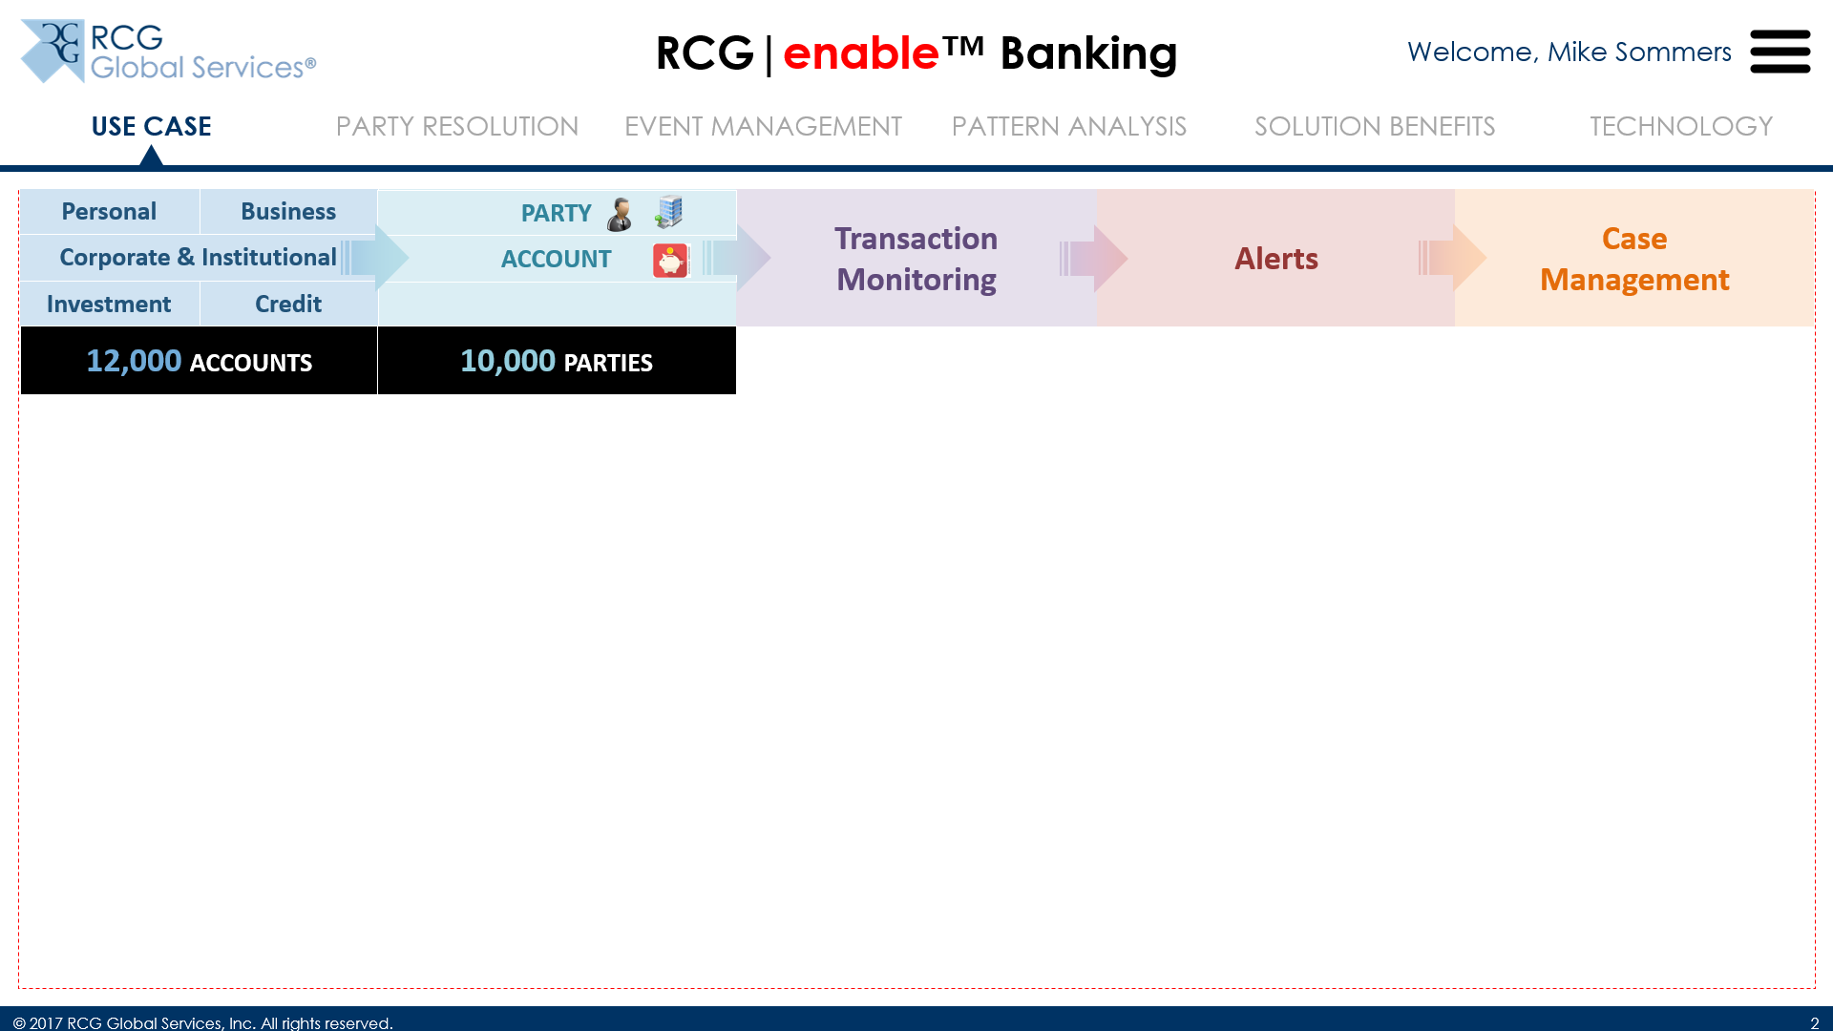
Use Case

Let’s say you have 12,000 accounts across your various lines of business (personal and commercial included)…

… that are held by 10,000 parties (who can be individuals or businesses)…

Slide 7
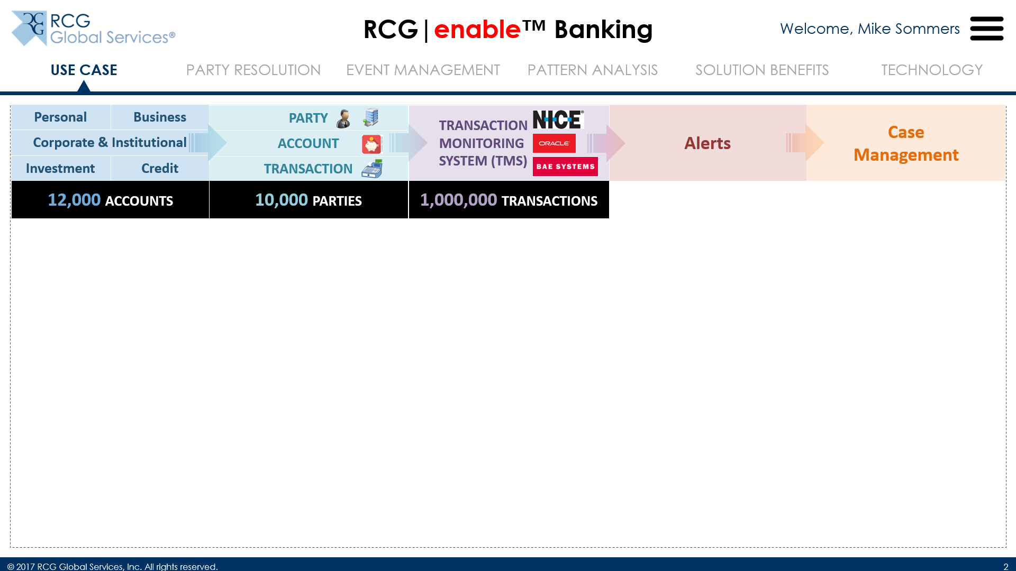
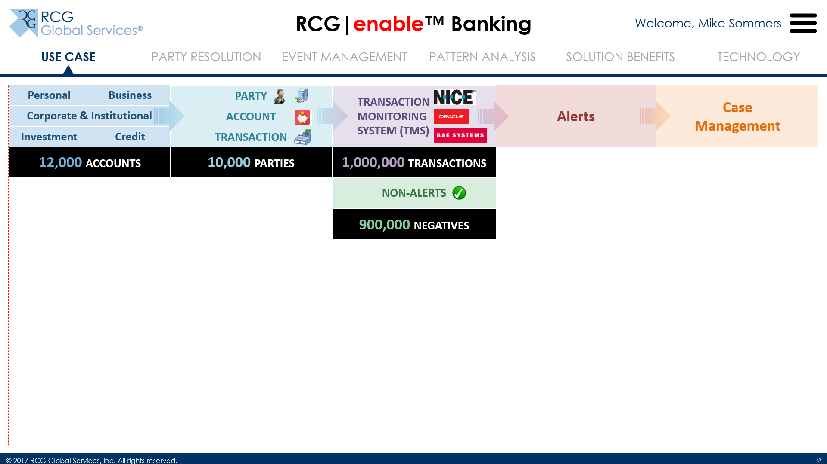
Use Case

… which generate a million transactions during the course of a month (or any other time period for that matter)

Let’s assume that 90% of these transactions (or 900,000) are determined to be non-alerts, or negatives, by the TMS…

Slide 8
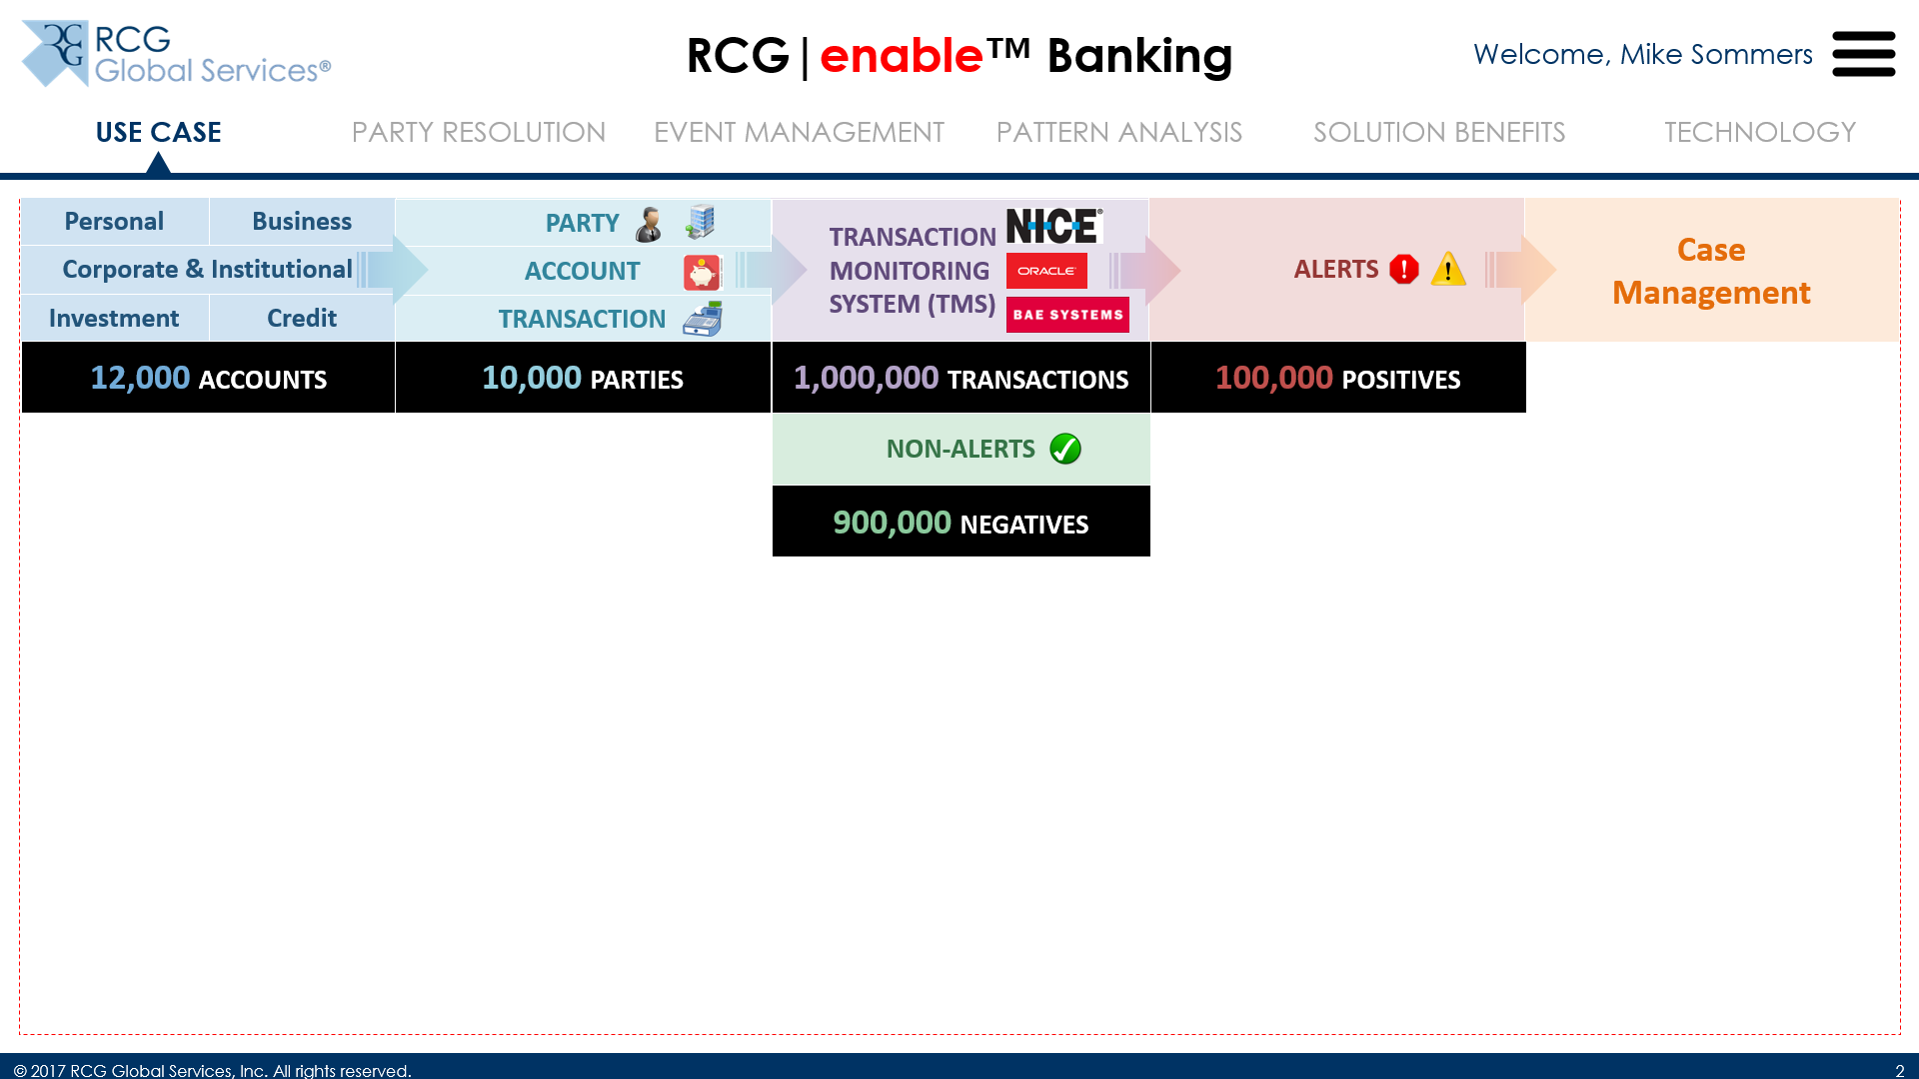
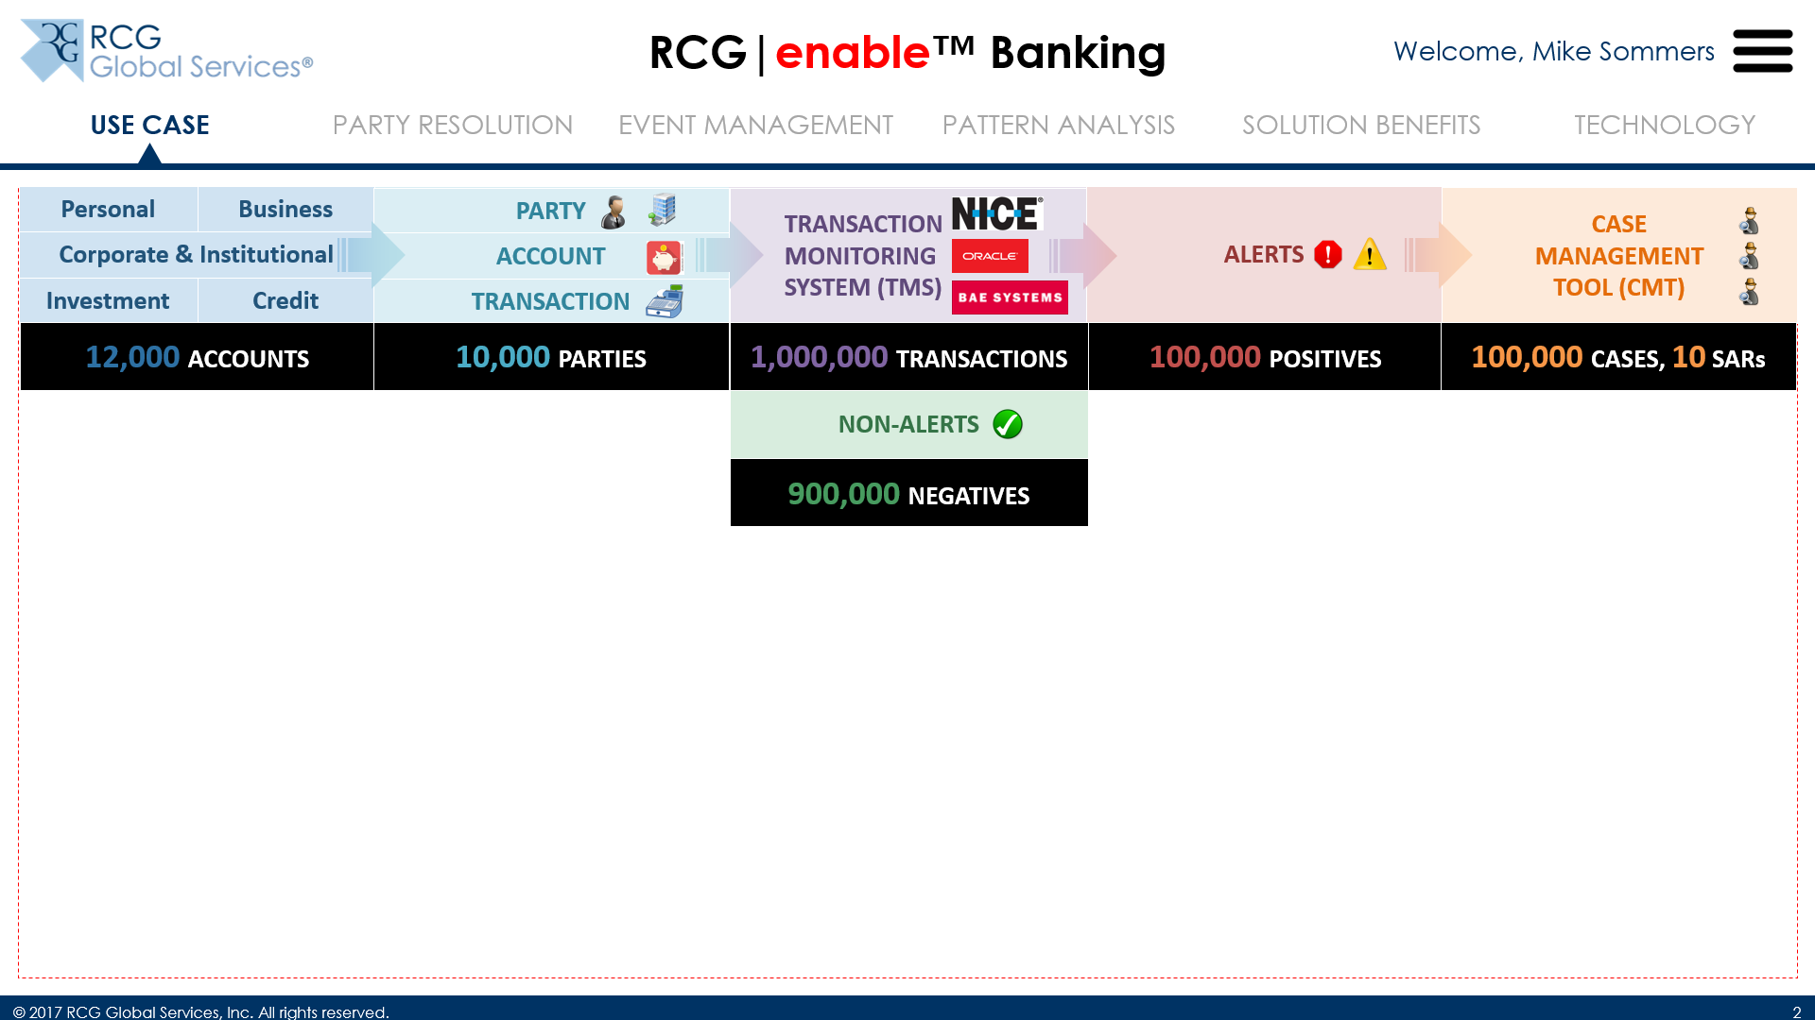
Use Case

… which leaves 100,000 transactions as alerts, or positives

… which could lead to potentially 100,000 cases to investigate, out of which 10 SARs (or CTRs) are generated; in our example, we’re assuming that each alert results in a case, but we will return to this later in the demo

Slide 9
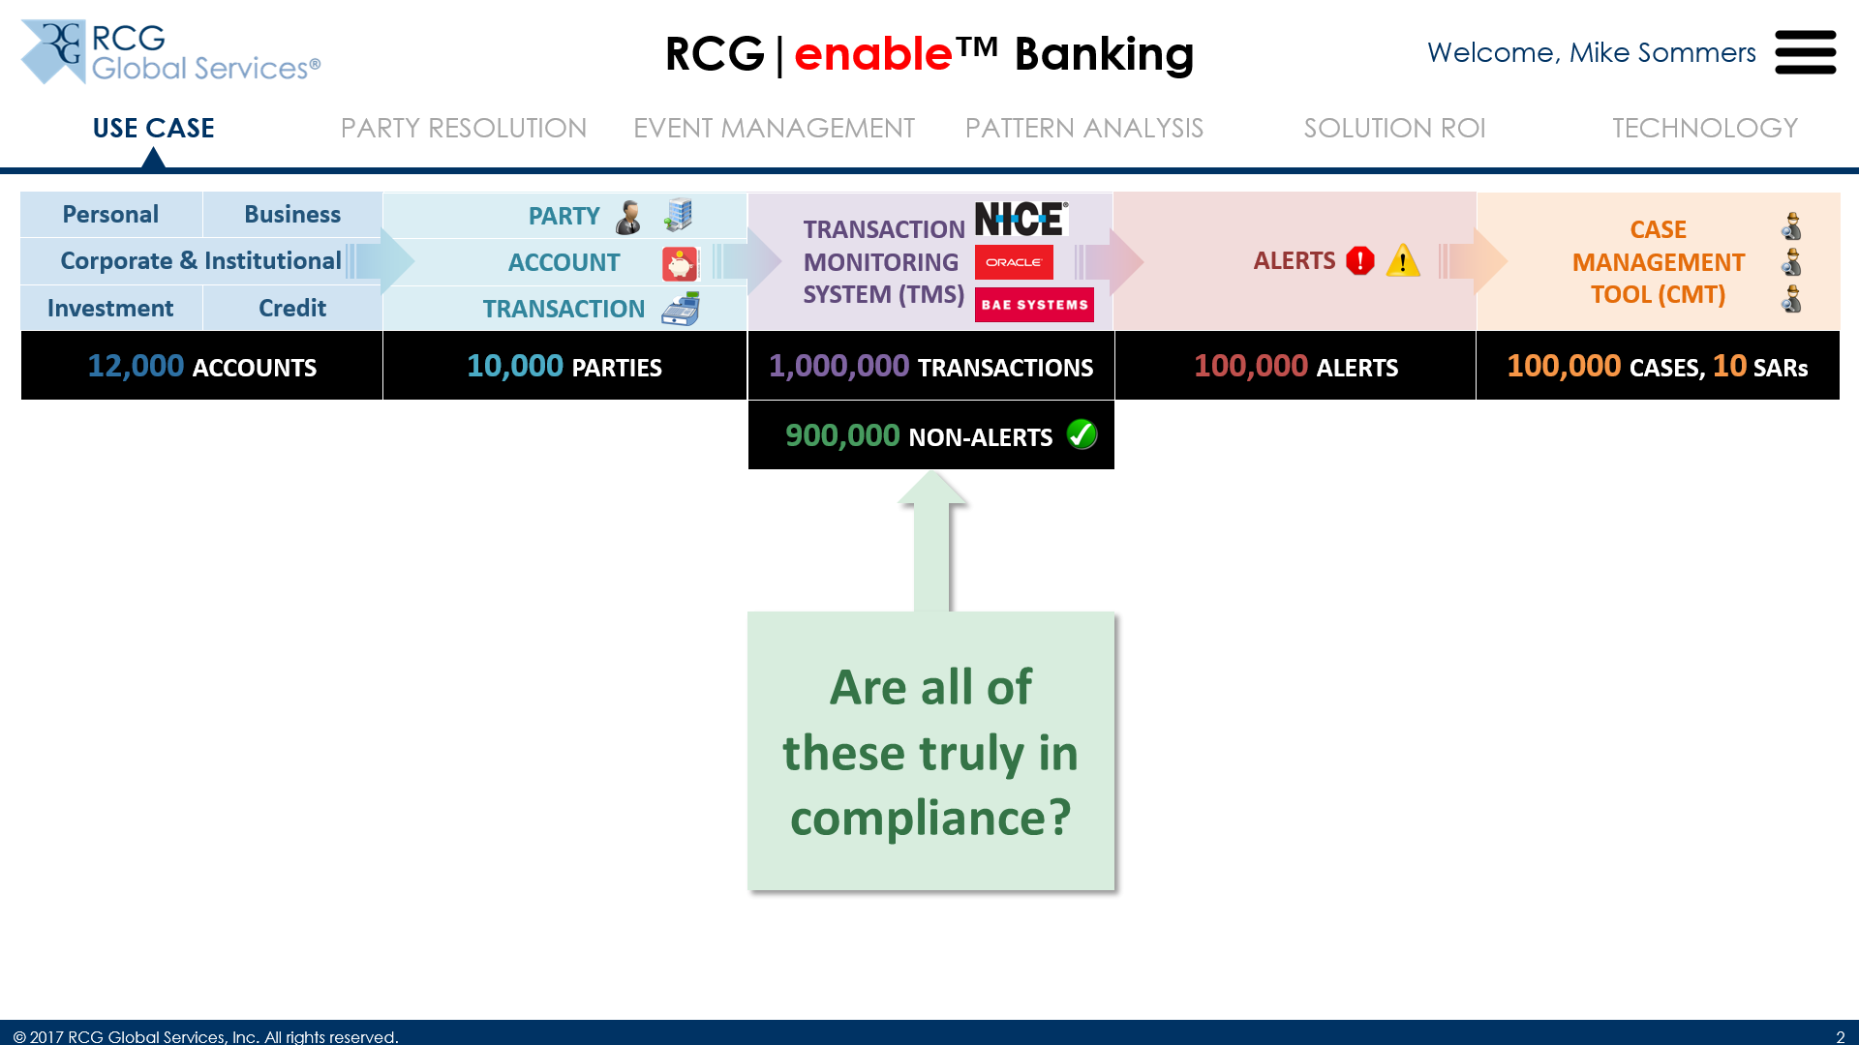
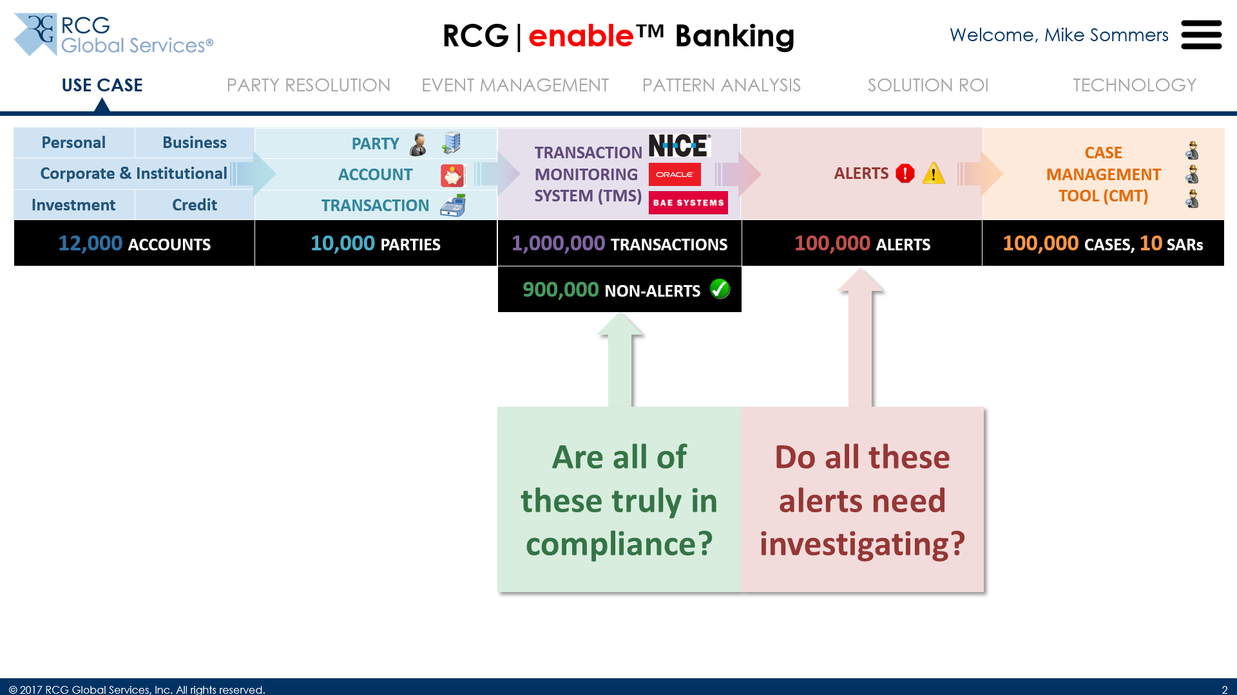
Use Case

Here are 3 questions to ask:
Are all of these truly in compliance? How many are false negatives? What is your compliance risk exposure?

Do all these alerts need investigating? How many are false positives? What is the investigative expense of these?

Slide 10
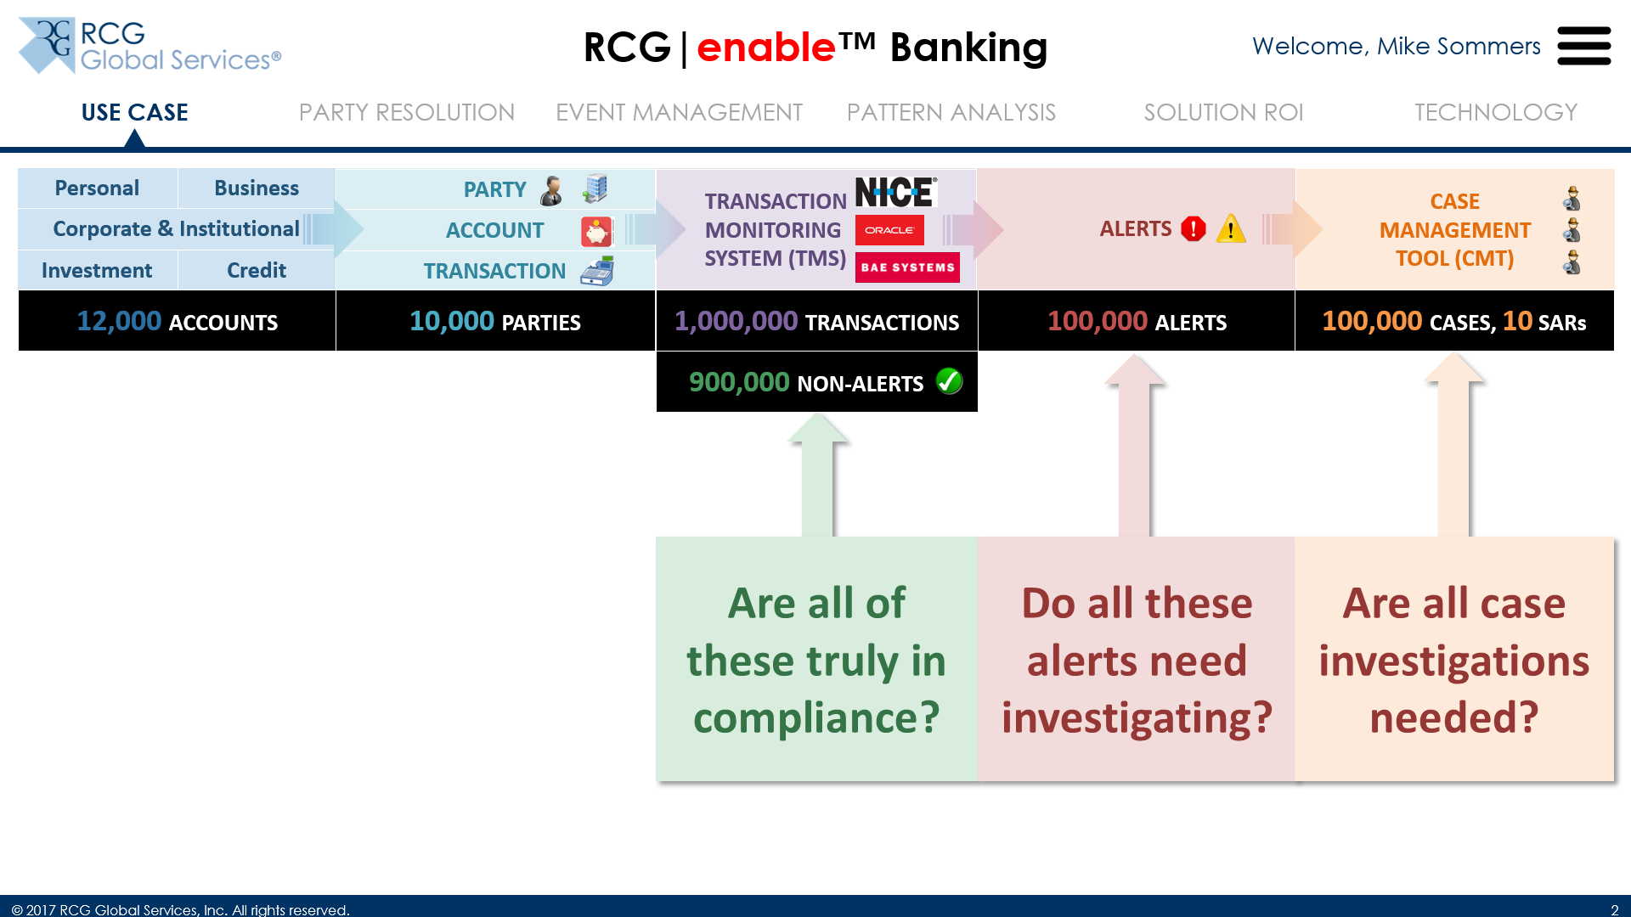
Use Case

Are all case investigations needed? Other than false positives, is there a smart way to reduce the overall number of cases to be investigated?

Slide 11
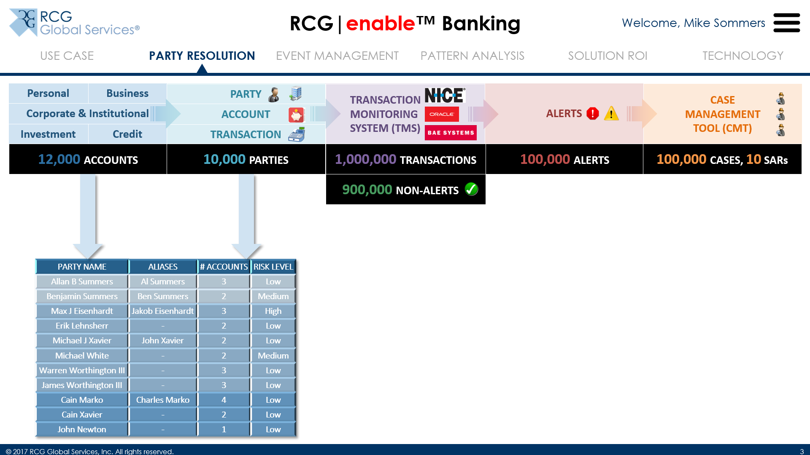
Party Resolution

To address these questions, let’s go back to our Core Data and start with the Parties, and the Accounts they hold
Here are some records with illustrative examples… some individuals appear multiple times with various spellings, nicknames, aliases etc., and sometimes the risk levels associated with them are different… how does this impact your risk segmentation?

Slide 12
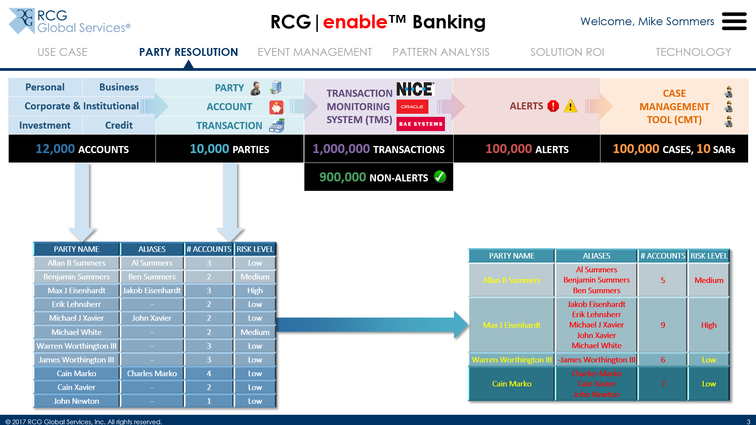
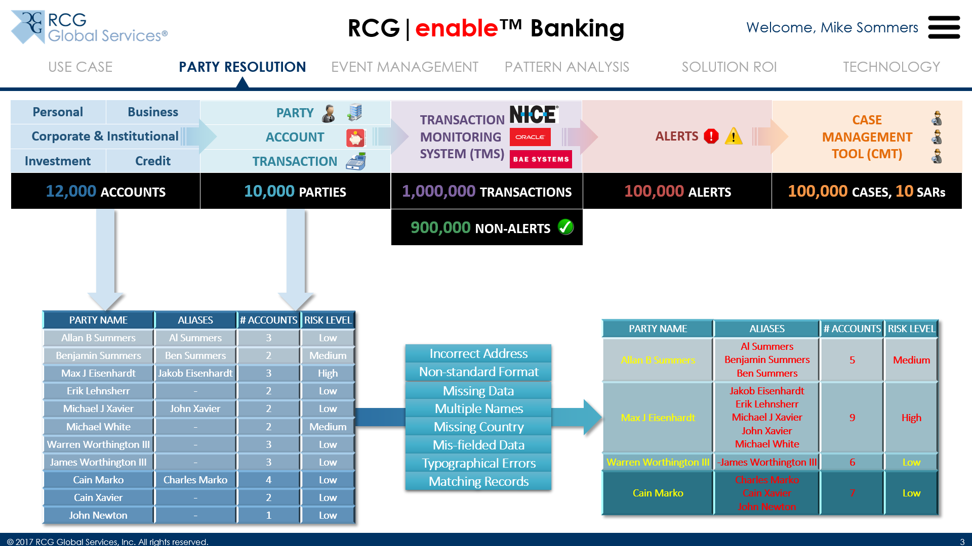
Party Resolution

Using data quality rules, our solution consolidates parties to identify duplicates, and potentially bad actors, and properly assigning risk levels (in this case a conservative approach is used where the highest risk level of the Party is chosen for all identities of that Party)

Some of the common data quality issues we see are listed here

Slide 13
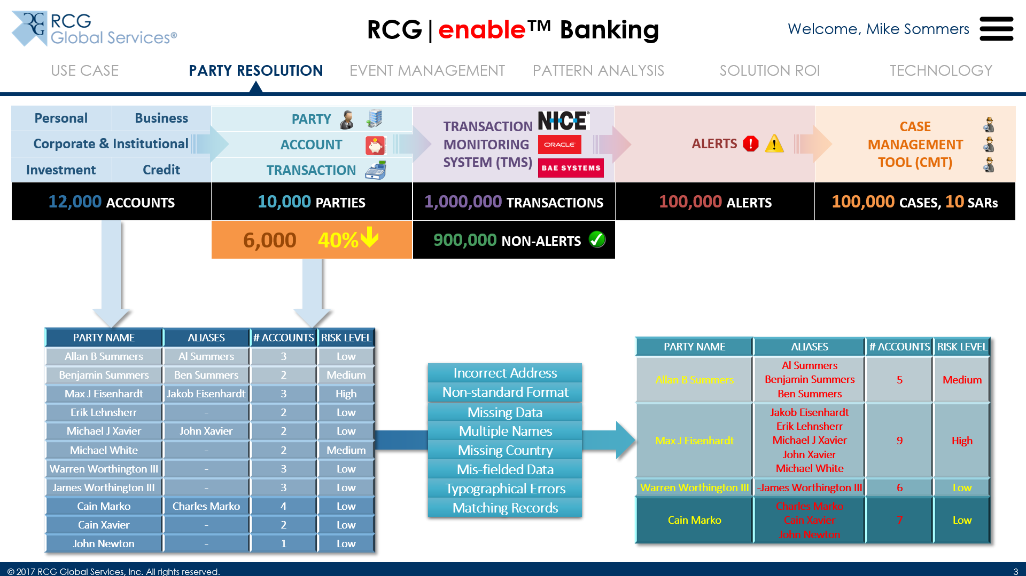
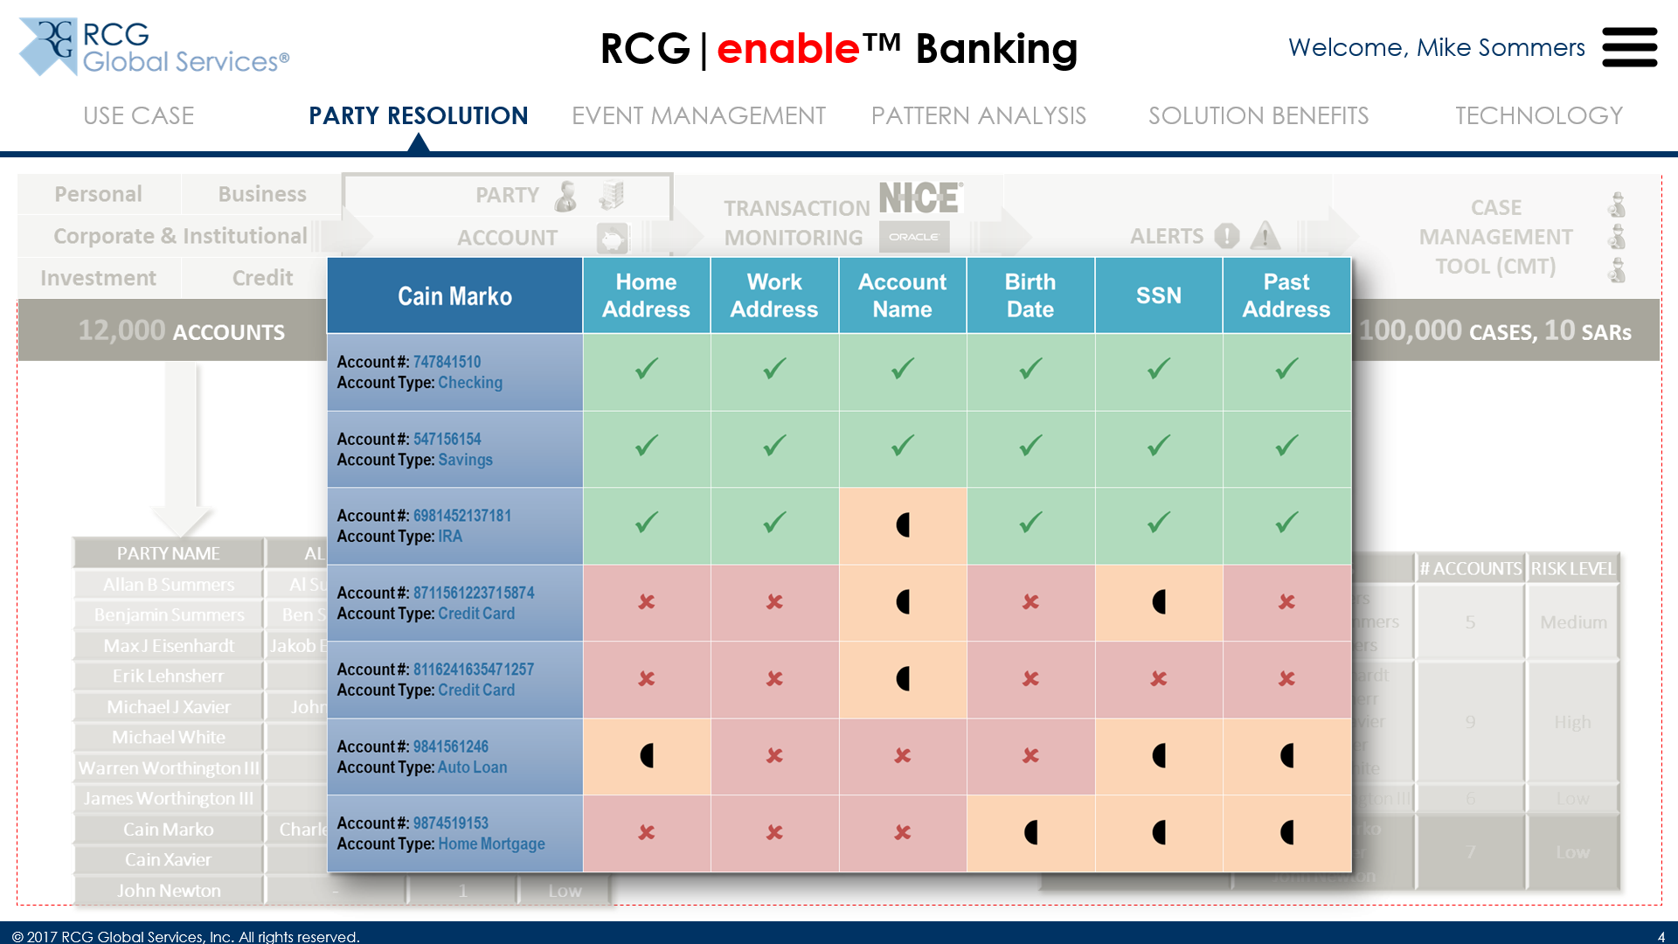
Party Resolution

Using Party Resolution, we’ve seen up to a 40% decrease in the number of unique parties

(Click on “Cain Marko”)
Resolving data quality issues also allows you to determine which data is accidentally obscured vs. deliberately obfuscated, thus enhancing your KYC compliance efforts

Slide 14
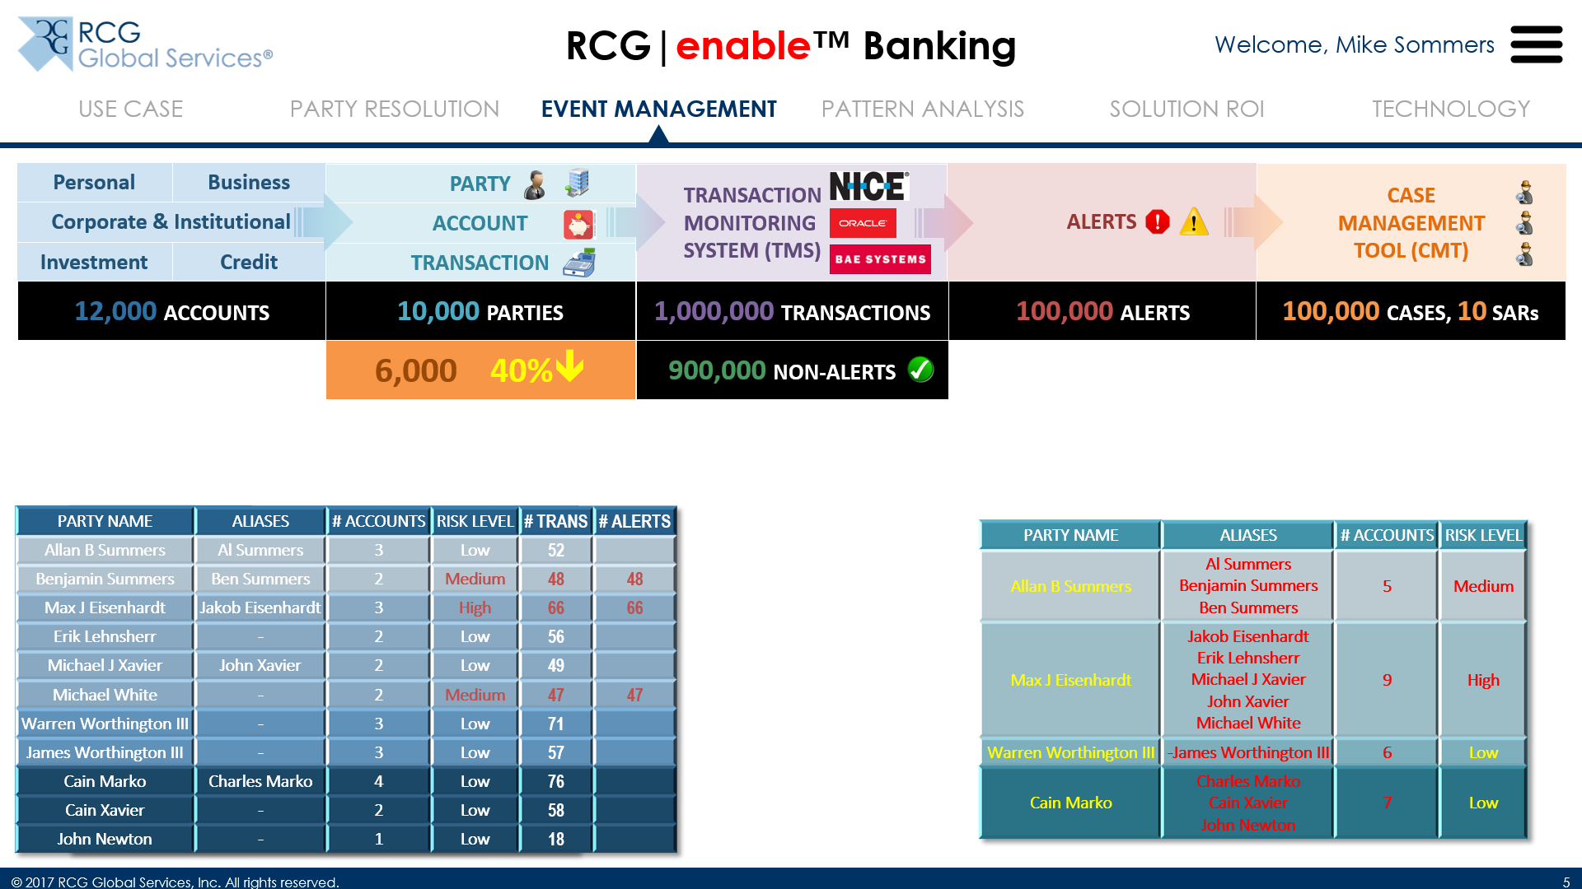
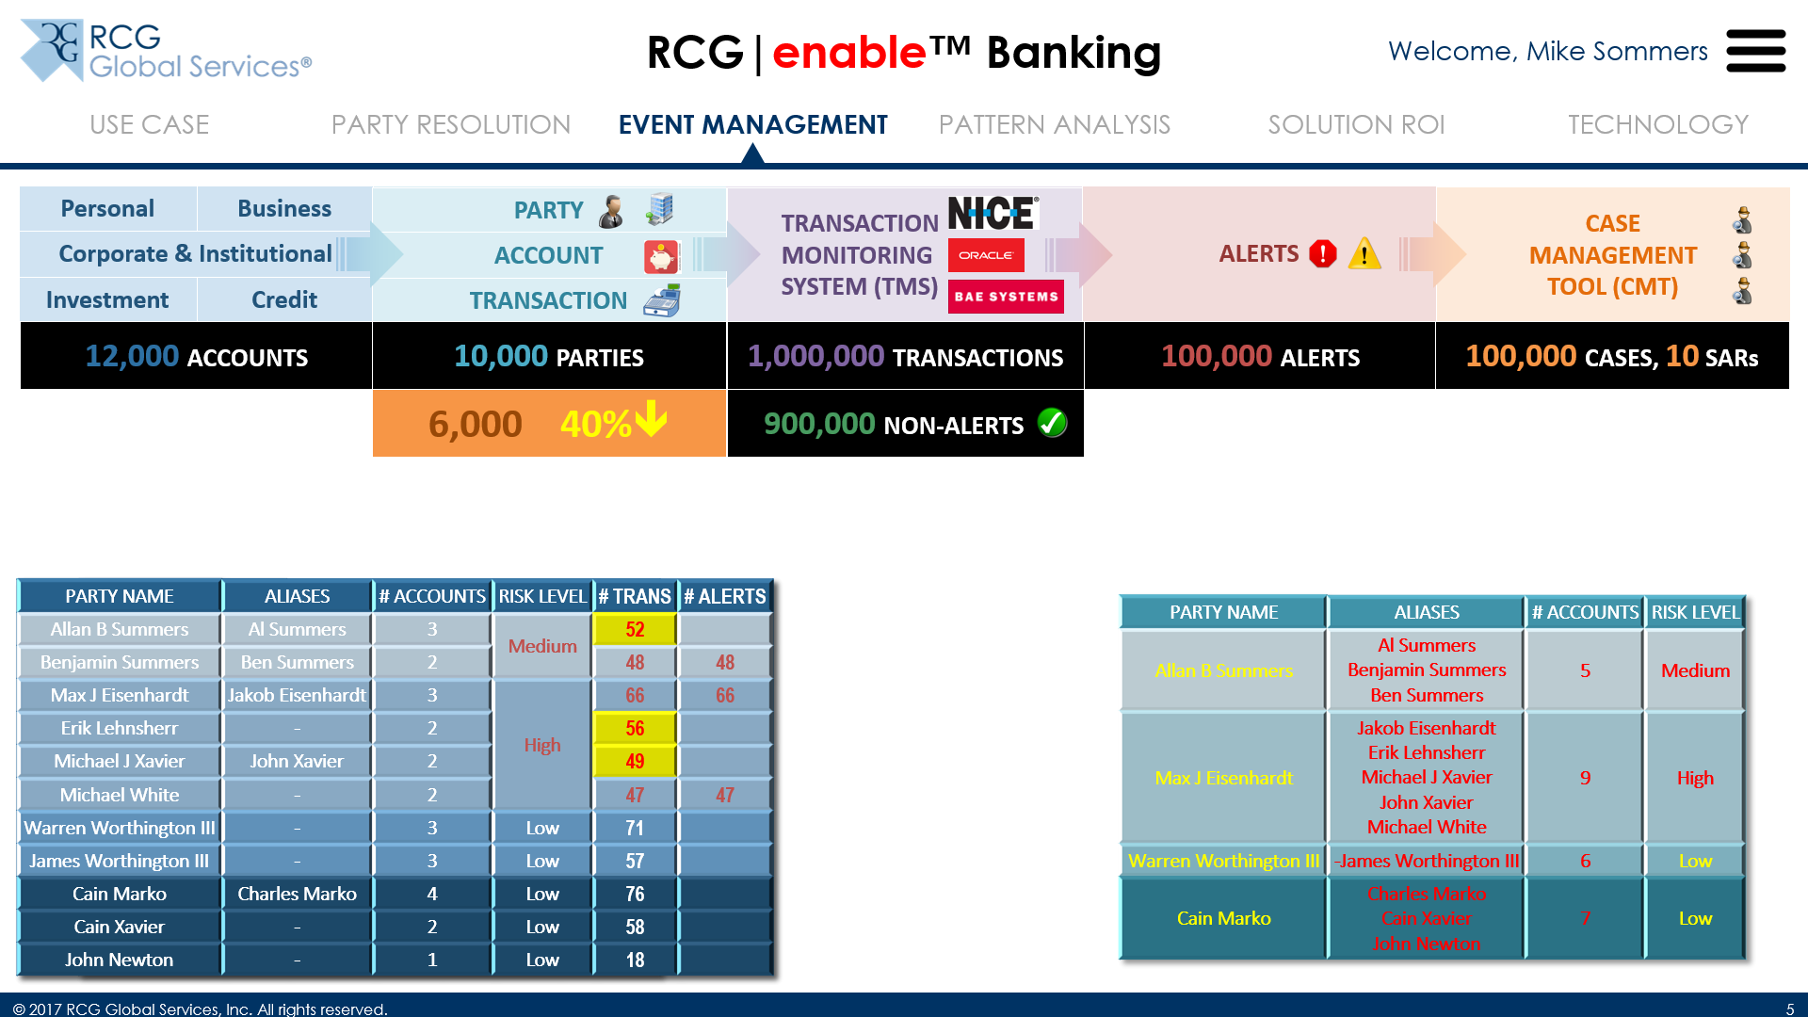
Event Management

Now let’s focus on transactions for these Parties and Accounts… let’s say that one of the TMS rules is to flag transactions with Medium and High risk Parties as alerts

After Party Resolution, an additional 157 transactions are flagged because the risk levels of the Parties have been adjusted

Slide 15
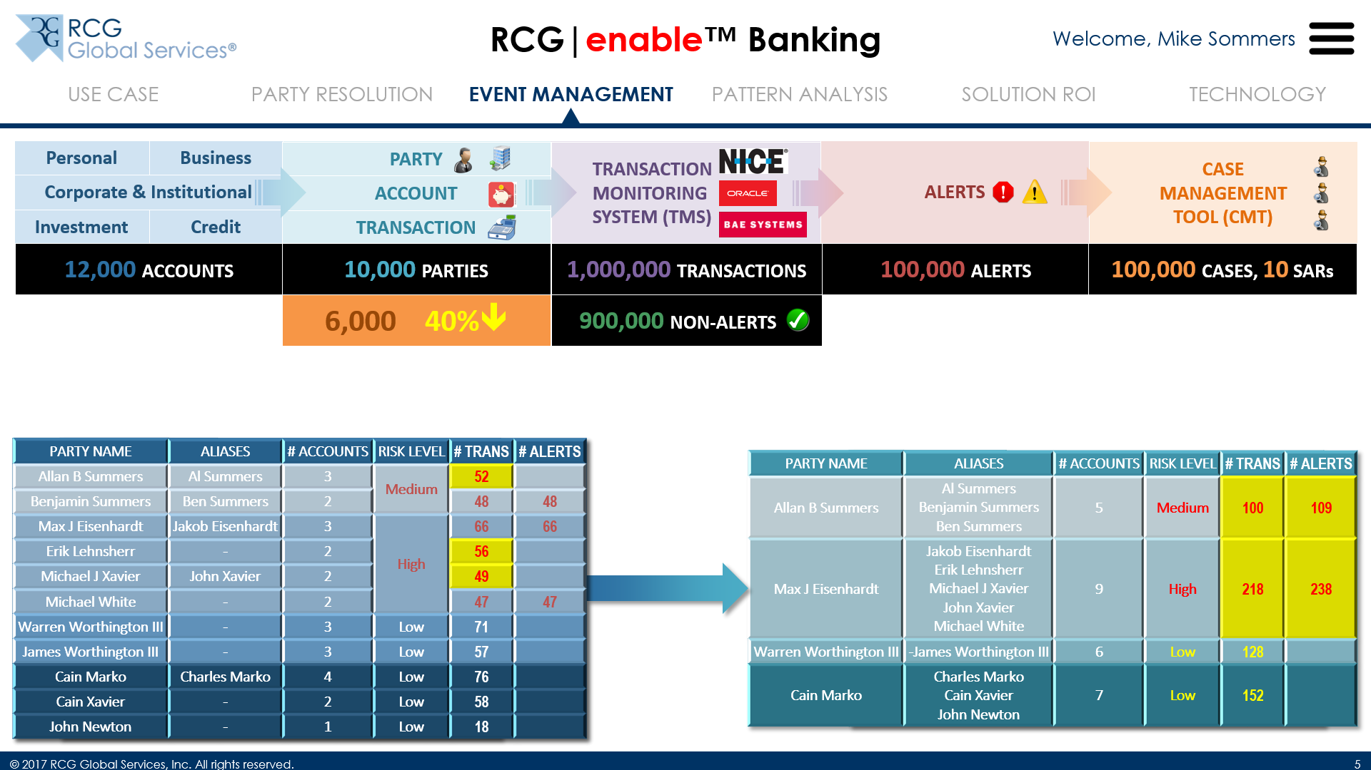
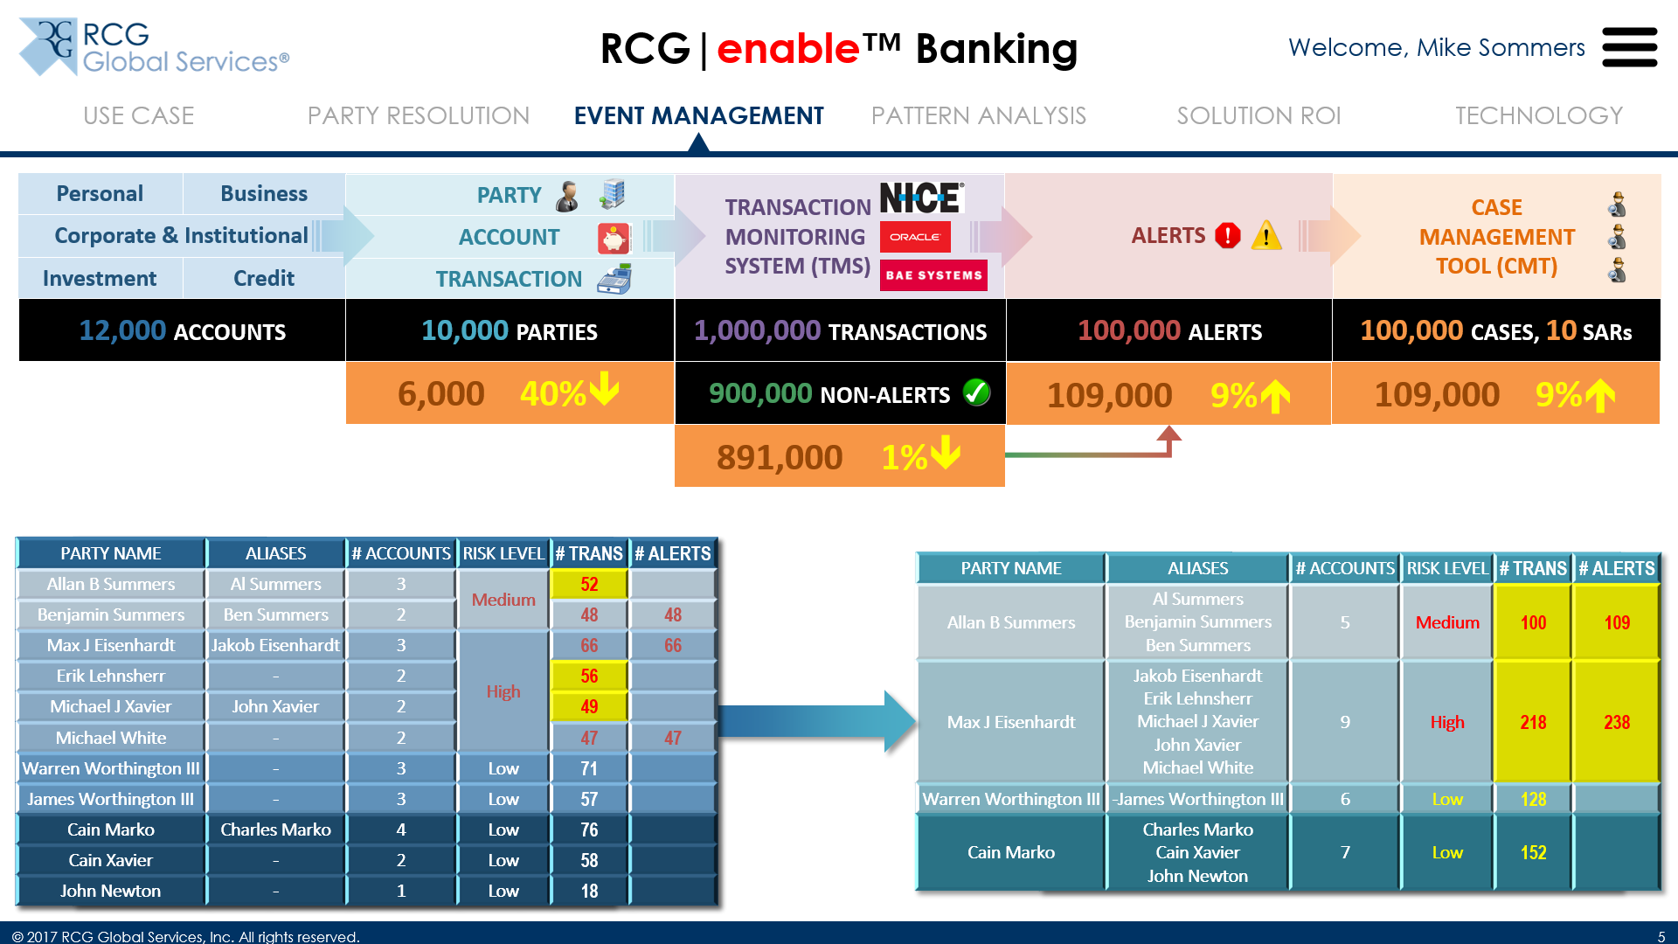
Event Management

Event Management consolidates the transactions based on Party Resolution and generates more alerts

We’ve seen about 1% decrease in the number of non-alerts (or “false negatives”), and about a 9% increase in the number of alerts; this makes you more compliant because you’re catching things that “slip through the cracks”

Slide 16
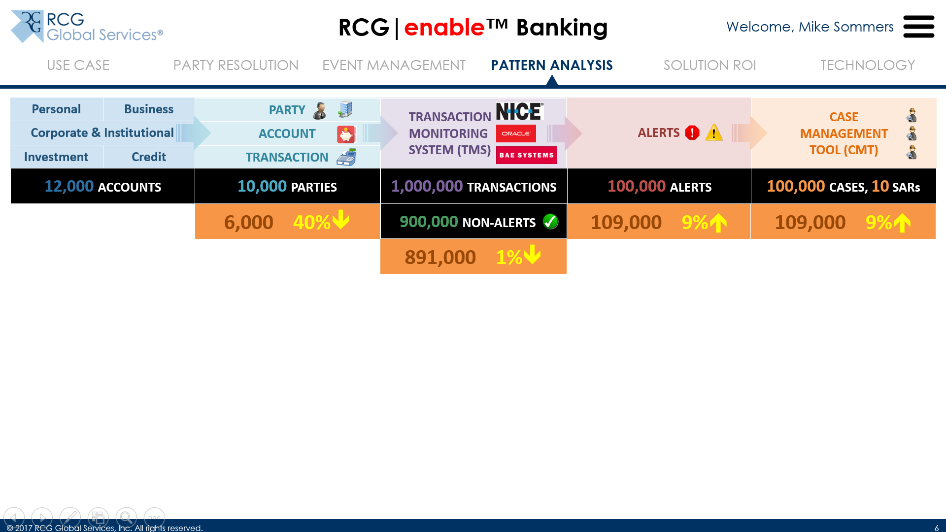
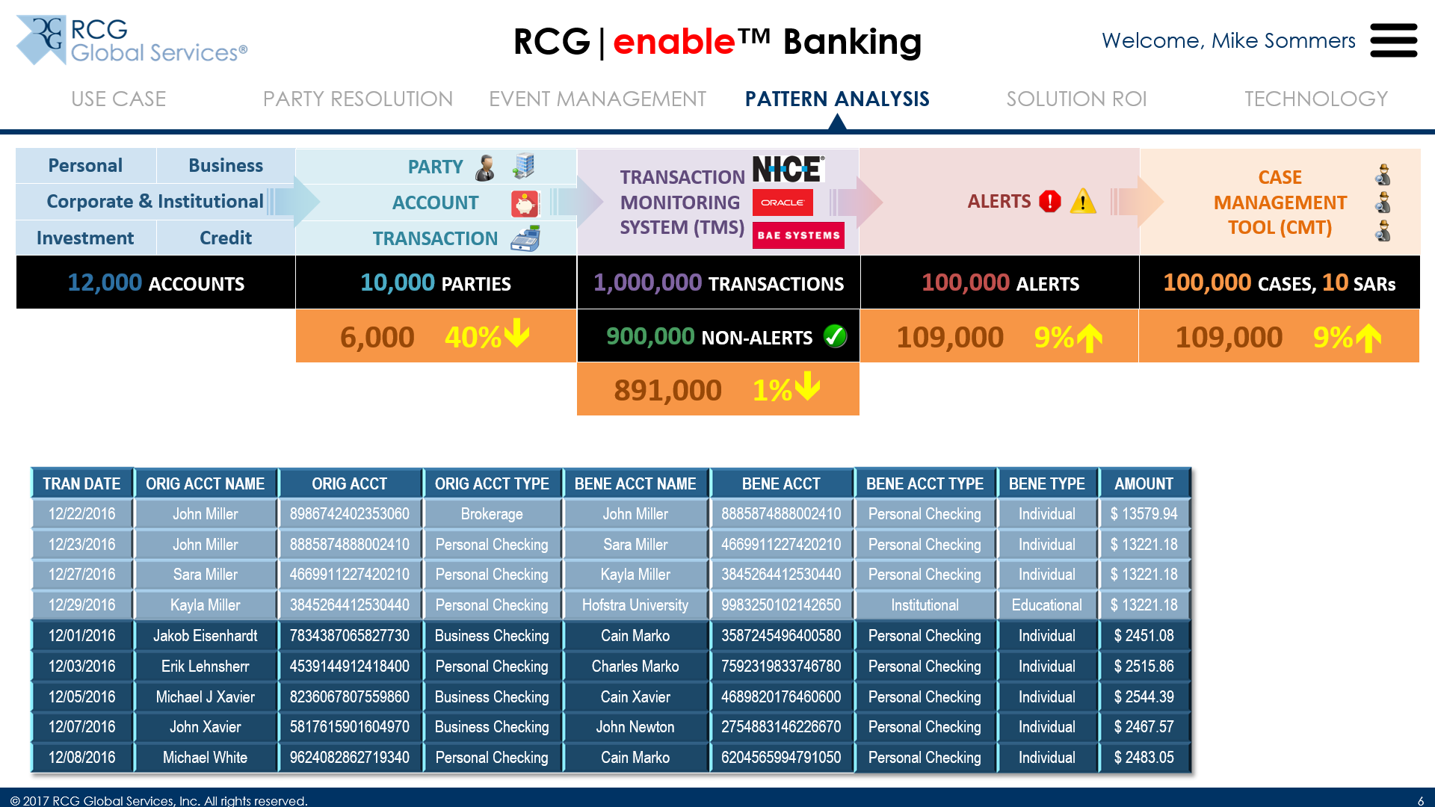
Pattern Analysis

In the process of improving compliance like we just saw, we increased the investigative burden. So, how do we deal with that? This is where Pattern Analysis comes in.

Let’s look at 2 sets of transactions, sorted by Date and Party as shown

Slide 17
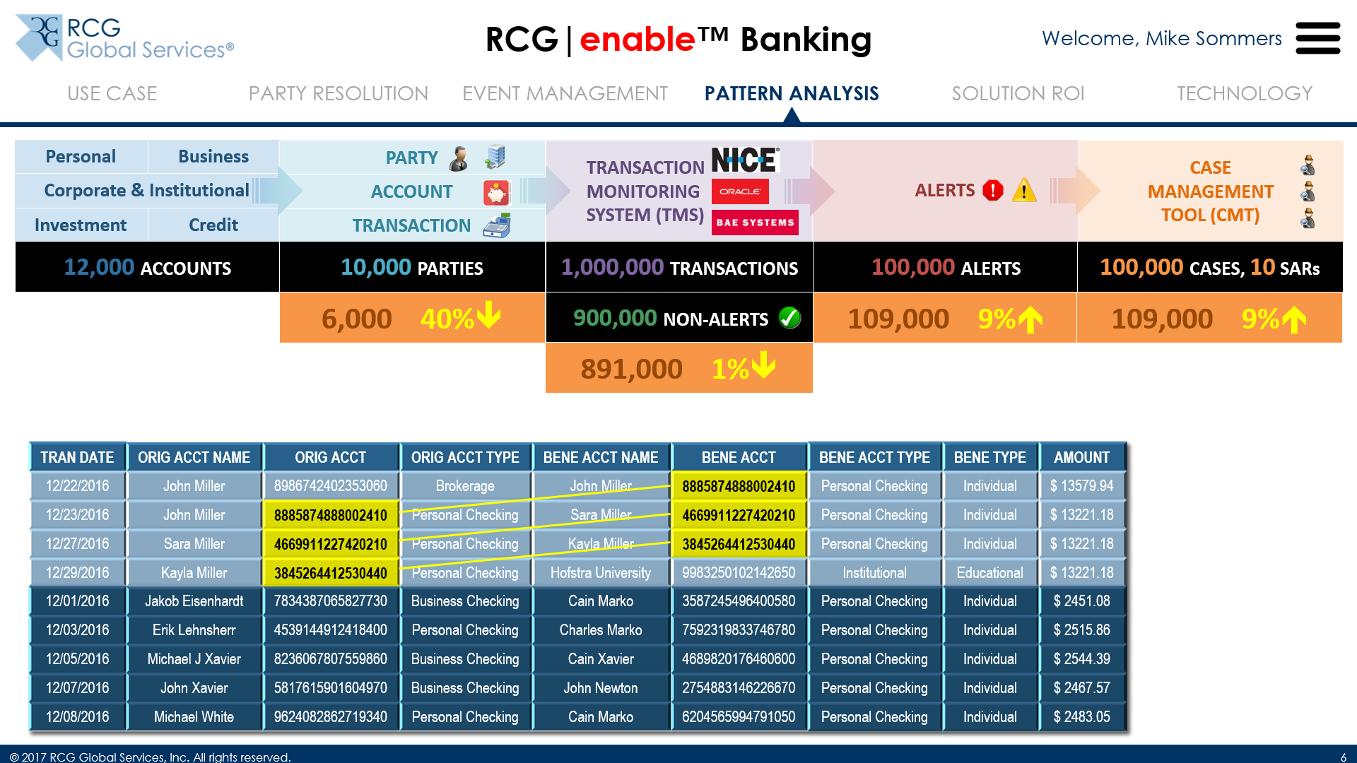

Pattern Analysis
 (Click twice)
Our solution is able to “stitch” together transactions based on common originating and beneficiary accounts, creating a set of related transactions

It is able to recognize that an educational institution that is on a known list of accredited institutions is the ultimate beneficiary, i.e., this is likely a college tuition payment and, therefore, benign

Slide 18
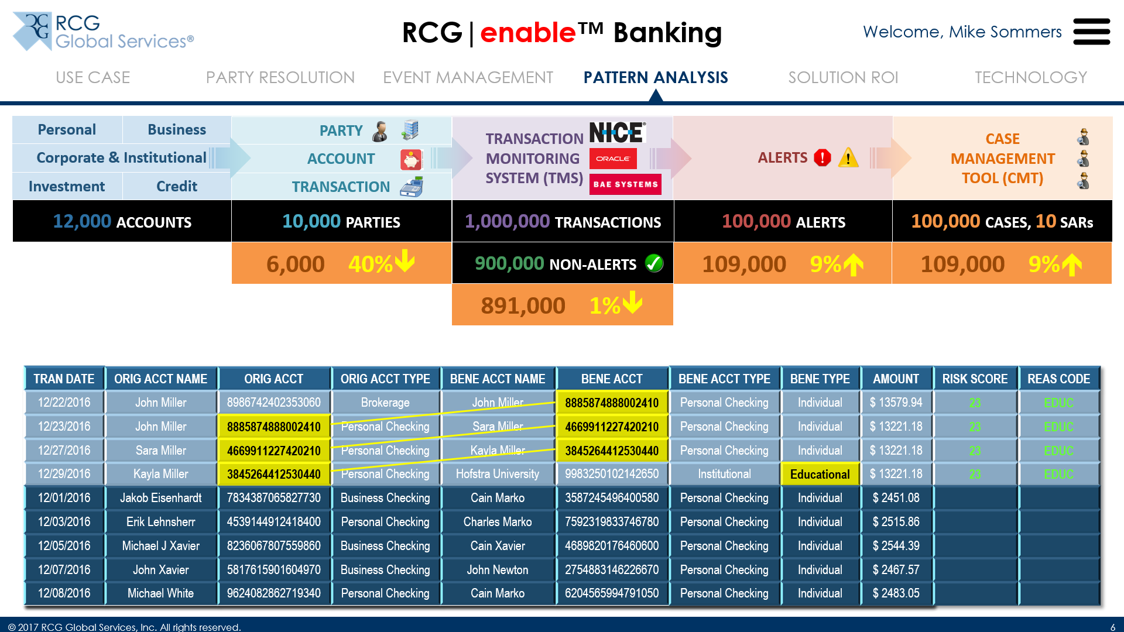
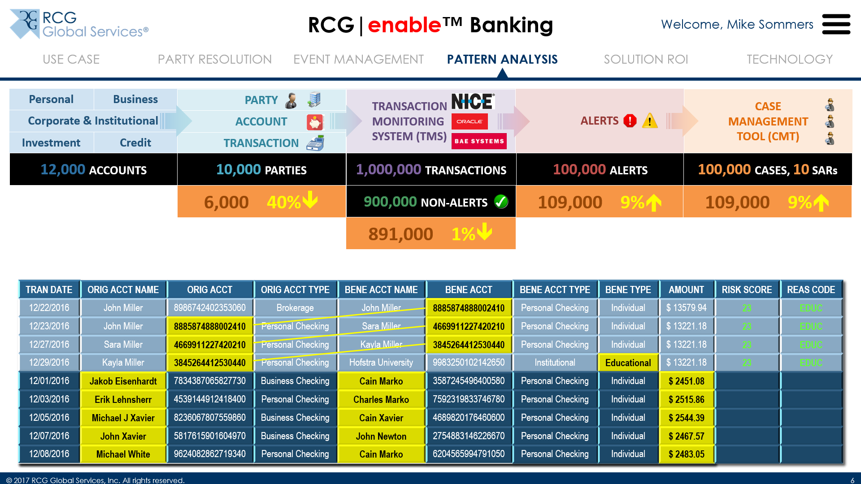
Pattern Analysis

The system assigns a low risk score to these transactions based on an algorithm, suggests or performs an “auto-close” of the case if configured to do so, and saves the pattern for future recognition and use
The algorithm is typically bank-specific, and we will build one for you based on your requirements

Now, let’s look at the second set of transactions… we recognize our bad actors, and the total amount from these transactions exceeds the $10,000 rule (from the SEC), suggesting possible malicious intent

Slide 19
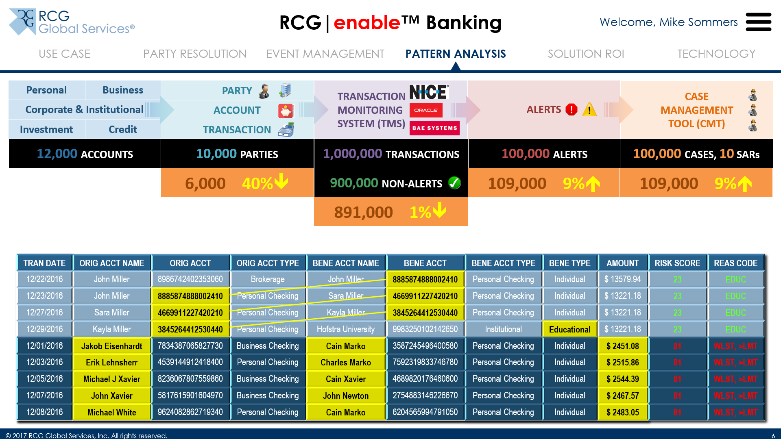

Pattern Analysis

These transactions, therefore, get a high risk score based on multiple criteria, in this case, Parties on the watch list, and total transaction amount over the limit

In this manner, we’ve typically seen a 24% drop in the number of alerts, thereby reducing investigative burden and, therefore, cost

Slide 20
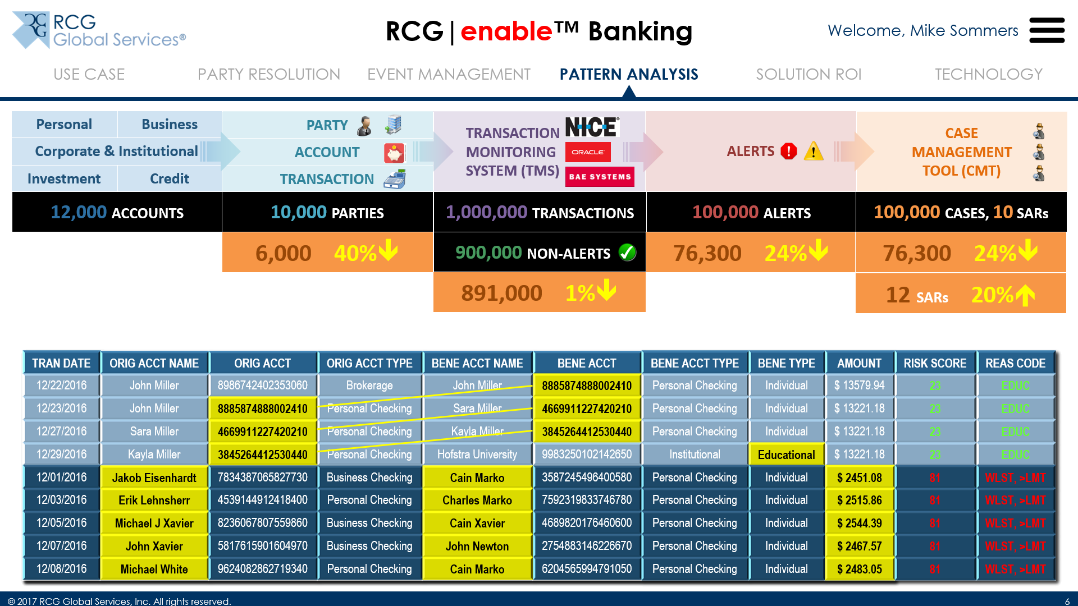
Pattern Analysis

Finally, these cases have resulted in the creation of 2 additional SARs, for the two Parties involved in the suspicious transactions; this makes you more compliant
That wraps up the overview of the RCG|enable™ Banking solution; now let’s talk about Solution ROI

Slide 21
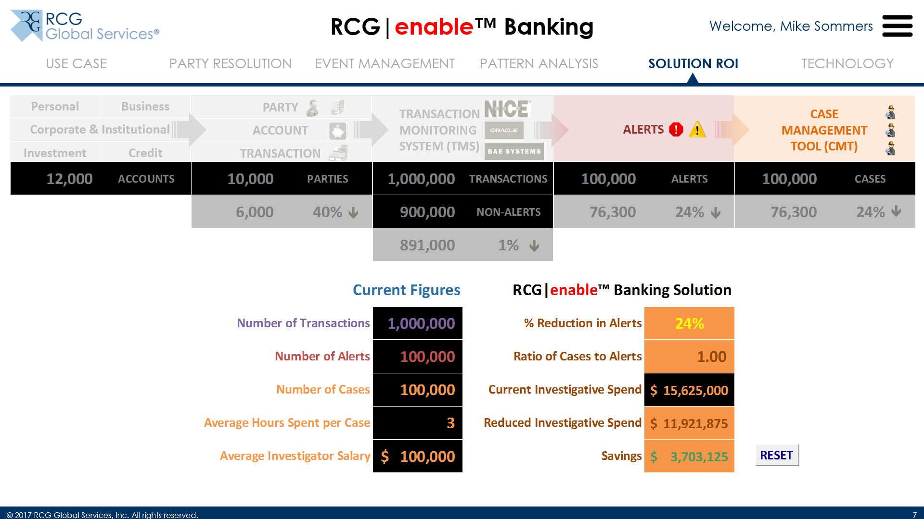
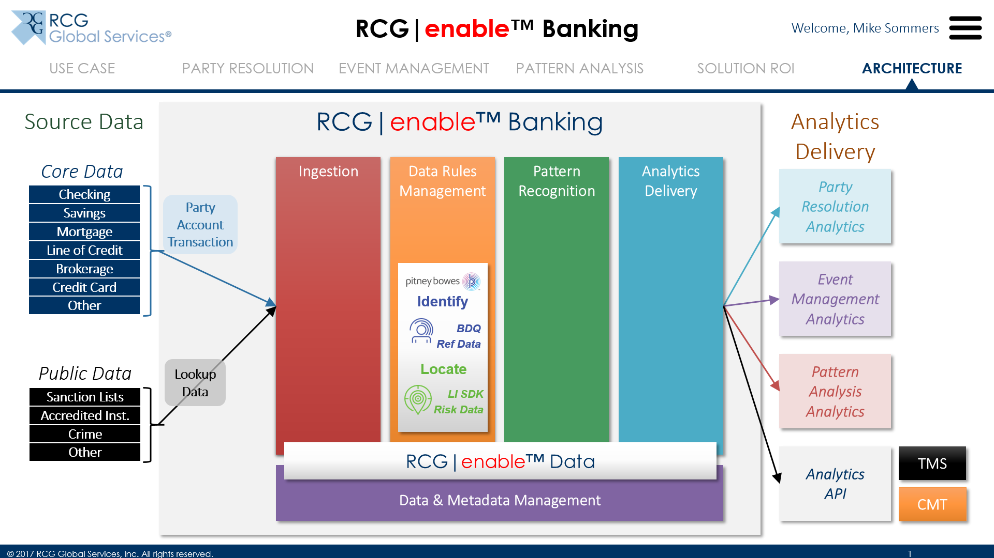
Solution ROI

We’ve modeled a simple calculator that’ll help us estimate ballpark savings based on some high-level inputs
(Engage the prospect in conversation here, and lead to how the solution can help pay for itself)

And finally, here’s the overall architecture of the solution
(Hand it off to the Solution Architect present, or encourage the prospect to schedule the next meeting where the Solution Architect will be present to take a deeper dive)

Slide 22
Our Promise
Our reputation is built upon the premise that we are a company that listens
We bring a creative view to your business initiative
We are collaborative and accountable as we jointly create your solution
We continuously innovate from concept to result and help you affect business change
There will be no surprises.
Ideas. Realized.®

